Slide 1
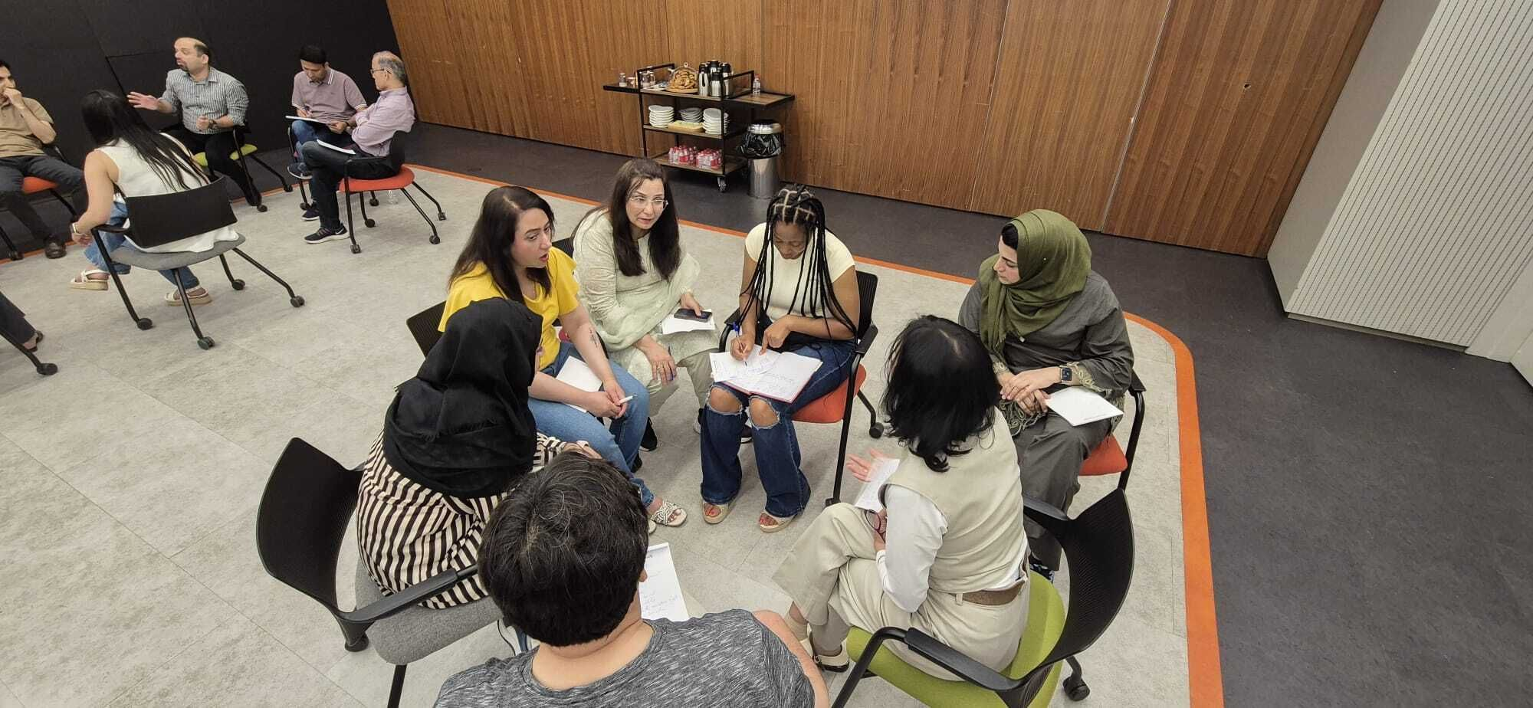



Rethinking
Funding Strategy
Applying it in practice.
Presented by BOND in collaboration with MzN International
LIVE WEBINAR, 3 Sept 26
© 2026 MzN International. All rights reserved.
Notes:
1

Slide 2
It begins with the “grants assumption”
Most funding conversations start by asking one question: how do we win more grants?
Before looking harder for scarce grants, it is worth asking a different question first. Could another form of capital do this job, either on its own or alongside grants?
The “grants assumption” may be wrong. But when may other forms of capital be open to us?
© 2026 MzN International. All rights reserved.
1

Slide 3
How should this be funded?
A rough guide to finding the right form of funding.
What needs funding? CAPEX · Activities · Research
Does it involve markets?
No
Grants and donations.
Fully subsidised.
Yes
Do users generate revenue?
E.g. Livelihoods, skills building, agriculture, energy, health
Yes
Is it scalable?
No
Grants plus investment capital. Modest, patient capital
Can this grow or be applied elsewhere?
Yes
Is there something innovative?
New product, methodology or solution
Yes
Predominantly private capital
An investable proposition
© 2026 MzN International. All rights reserved.
2

Slide 4
Does it touch markets? You have more options
No market involvement
Markets involved
Partially market based
Fully market based
Concessionary Capital
Grants, donations
Private Capital
Bonds, blended finance, investments
Traditional Grants & Donations
Investing for Impact
Primarily impact motivated. Often want to preserve capital.
Investing with Impact
Value social, climate and justice impact as much as financial return.
Sustainable and Responsible Investing
Traditional Investing
© 2026 MzN International. All rights reserved.
3

Slide 5
More possible sources of capital
No market
involvement
Markets
involved
Partially market
based
Fully market
based
Concessionary Capital
Private Capital
Grants, donations
Bonds, blended finance, investments
Development aid agencies, philanthropic donors, corporate foundations
Traditional Grants & Donations
Development finance institutions, high net worth individuals
Investing for Impact
Primarily impact motivated. Often preserve capital.
Impact investment firms, corporate impact funds
Investing with Impact
Value social, climate and justice impact as much as return.
Banks, institutional investors, corporate venture funds
Sustainable and Responsible Investing
Everybody and every form of capital
Traditional Investing
© 2026 MzN International. All rights reserved.
4

Slide 6
OUR TEST
Can we really do that? How we answer it!
We apply these basic questions to every project before we say yes.
01
02
03
Lives changed
Big enough to matter
A model that holds up
not just activities delivered.
commercially and materially.
methodologically and financially.
04
05
06
Risk we can live with
Communities in the lead
A credible path to capital
on delivery, policy and partners.
consent, governance, benefit sharing.
from the first pound to full funding.
© 2026 MzN International, LLC. All rights reserved.
6

Slide 7


Slide 8


Slide 9


Slide 10


Slide 11
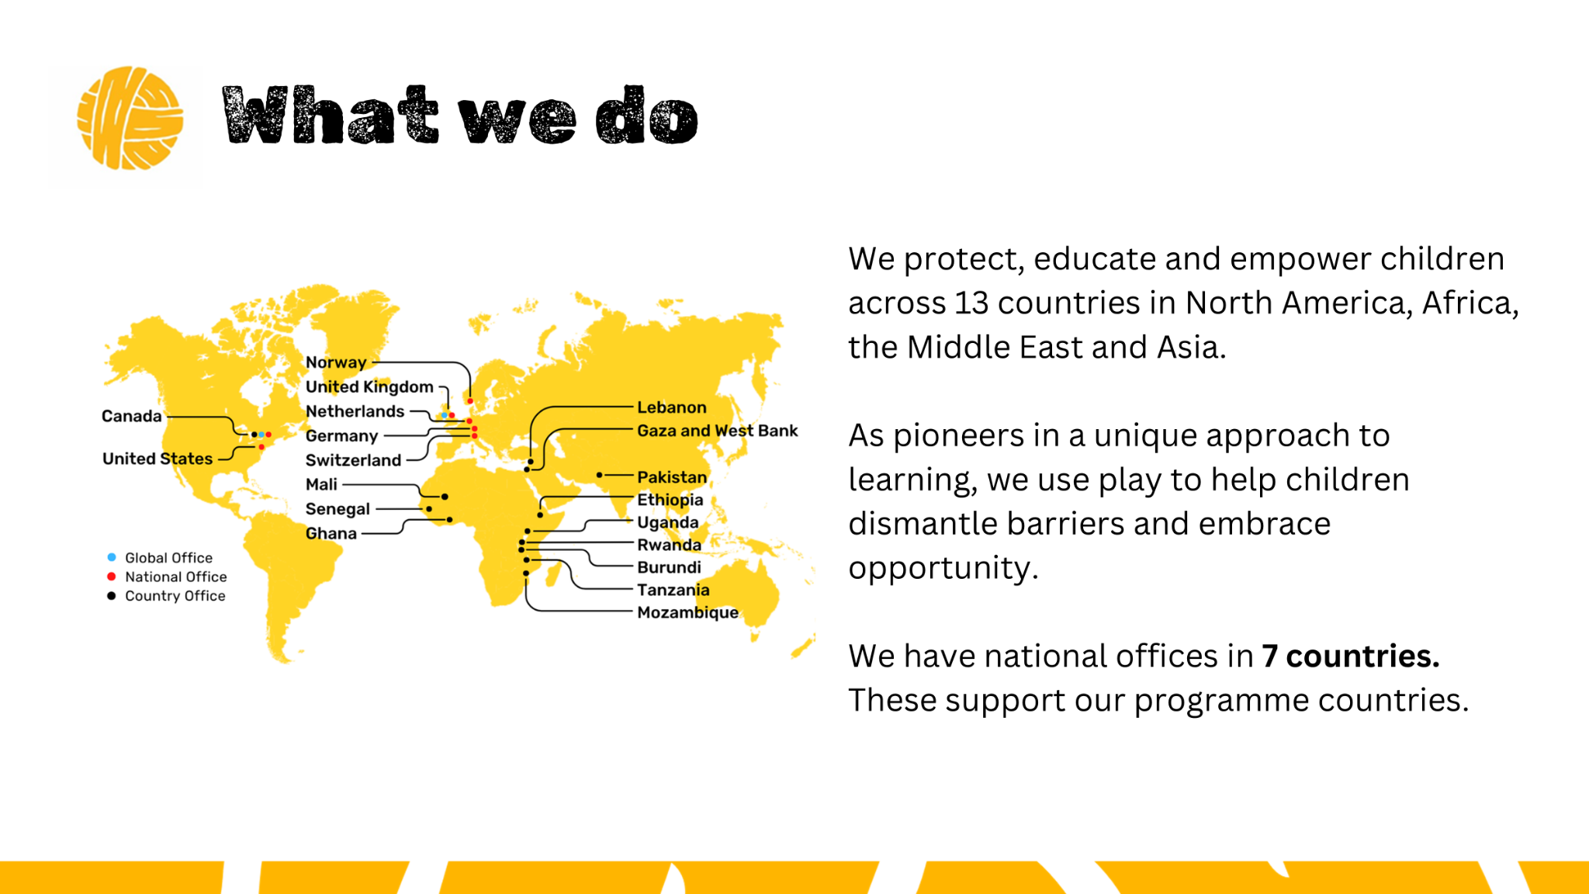

Slide 12
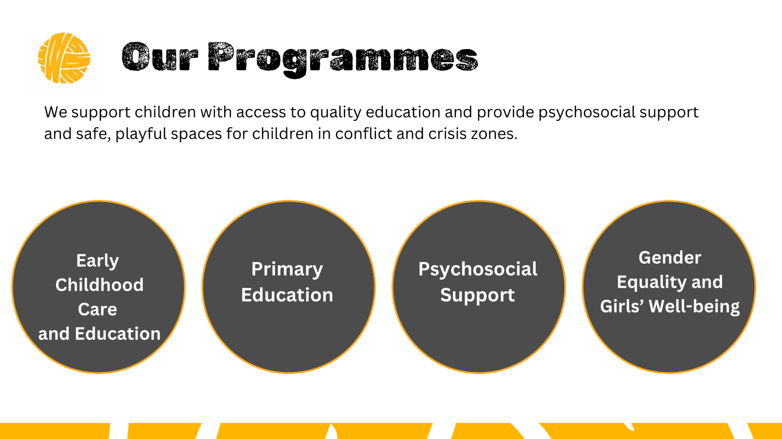

Slide 13


Slide 14
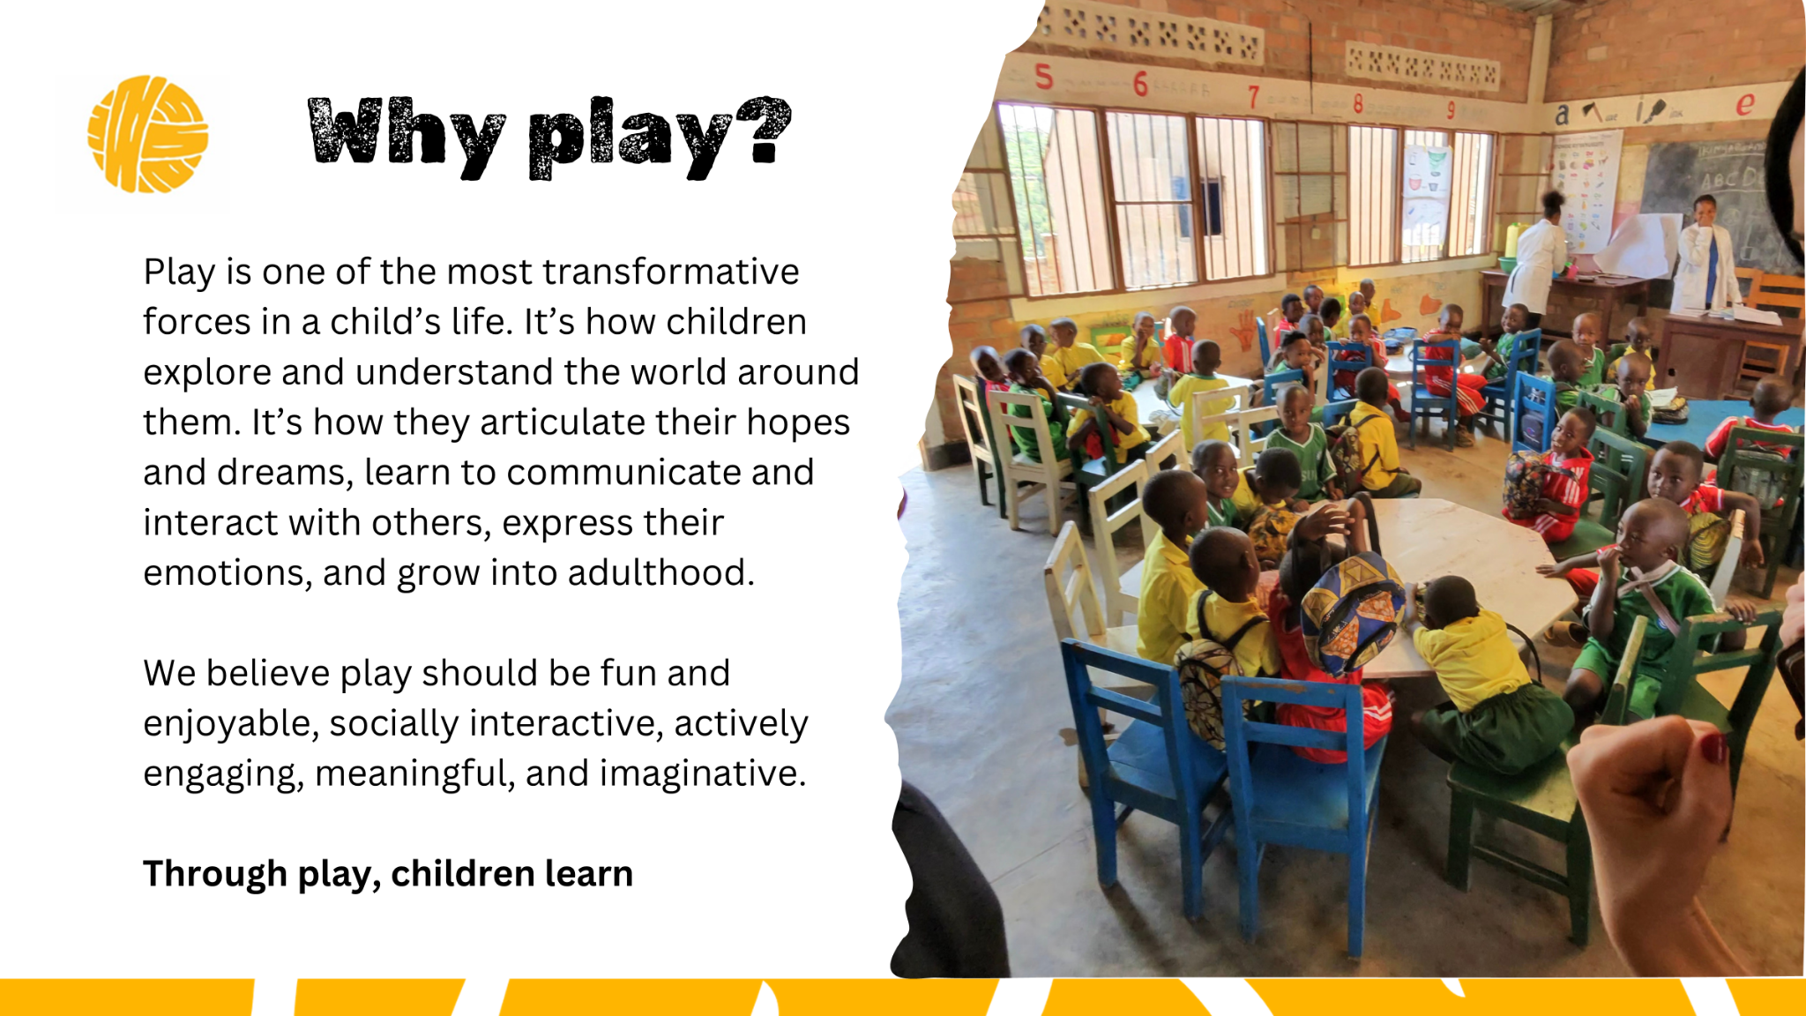

Slide 15


Slide 16


Slide 17
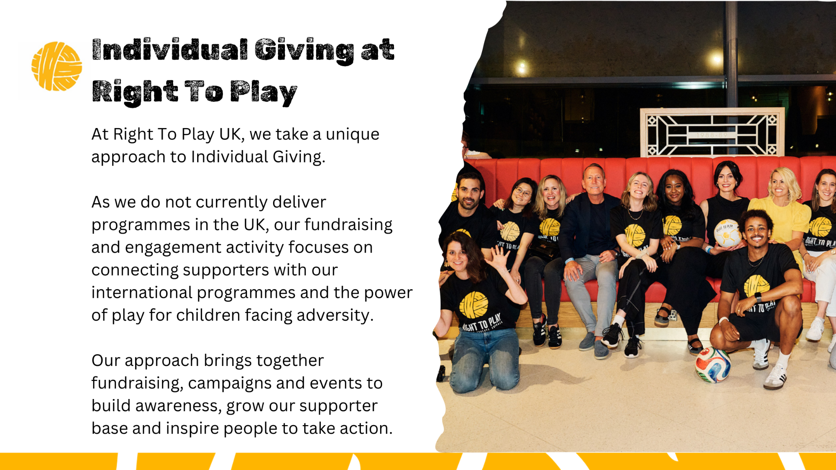

Slide 18
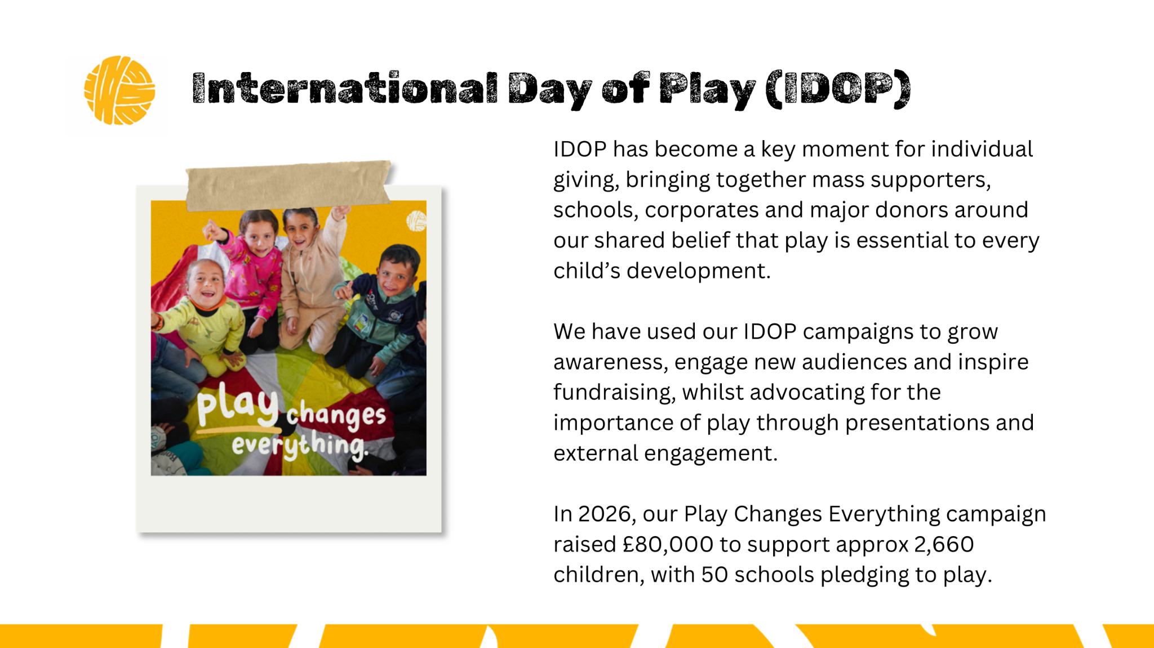

Slide 19


Slide 20


Slide 21

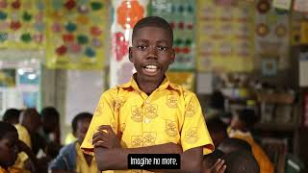

Slide 22


Slide 23


Slide 24
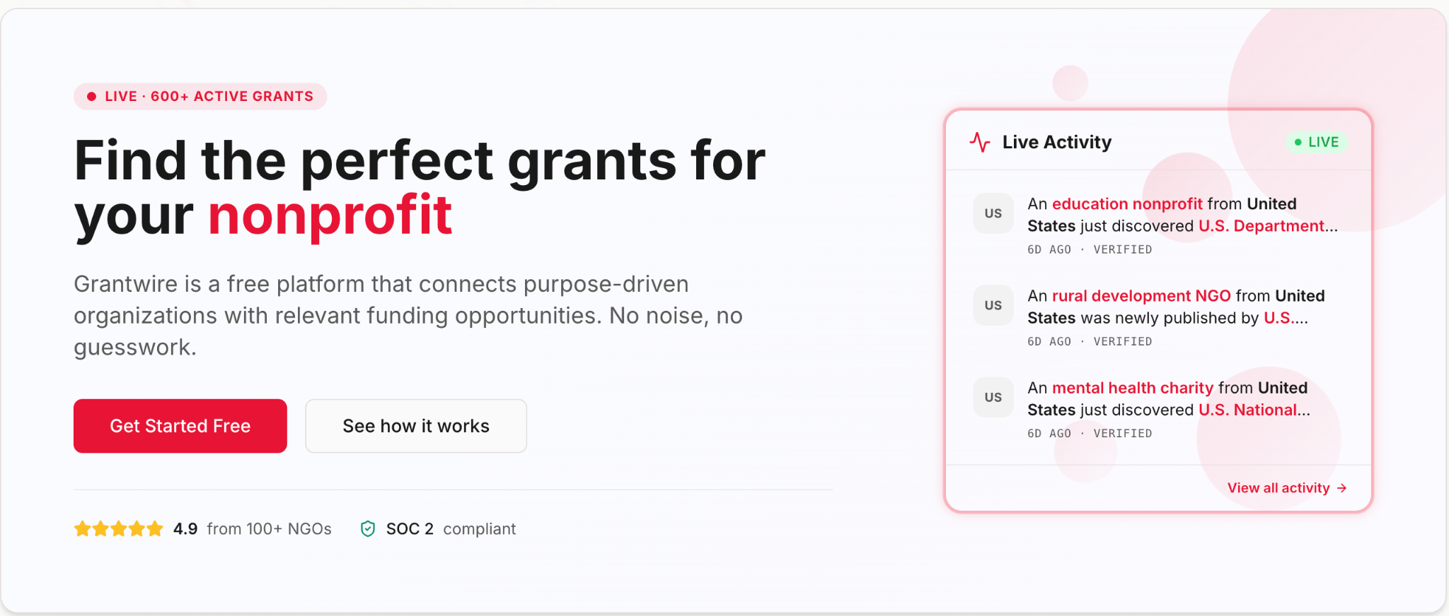
Grantwire
Grantwire monitors over 5000+ grant sources every day and flags the opportunities worth your time.
Funding intelligence, forever free
5,000+
sources monitored every day
Sign up at www.grantwire.org
Fit, not noise
Learns to match to your mission and size
Free
to use, across the sector
© 2026 MzN International. All rights reserved.
7

Slide 25
A closing thought
If we want to attract more capital than we ever had, we need to do things we never did.
Culture, cost, risk appetite, and legal and organisational blockages are real hurdles. But they can be worked through, deliberately and in the right order.
WHERE WE USUALLY START
We think. Together. Our Sprint workshops (see here) are a cost effective way to explore how to proceed, before you commit budget or people.
© 2026 MzN International. All rights reserved.
8

Slide 26

Thank you.
Now over to you.
Questions, challenges, sceptical pushbacks. All welcome.
STAY IN TOUCH
Christian Meyer zu Natrup, Managing Director, MzN International
www.mzninternational.com · www.grantwire.org · Bond network member.
Slides and resources will be circulated after the webinar.
© 2026 MzN International. All rights reserved.
Notes:
24

