Slide 1
Total Reward Strategies for UK NGOs: Insights from 2025
How NGOs in the UK are Managing Workforce and Pay

Slide 2


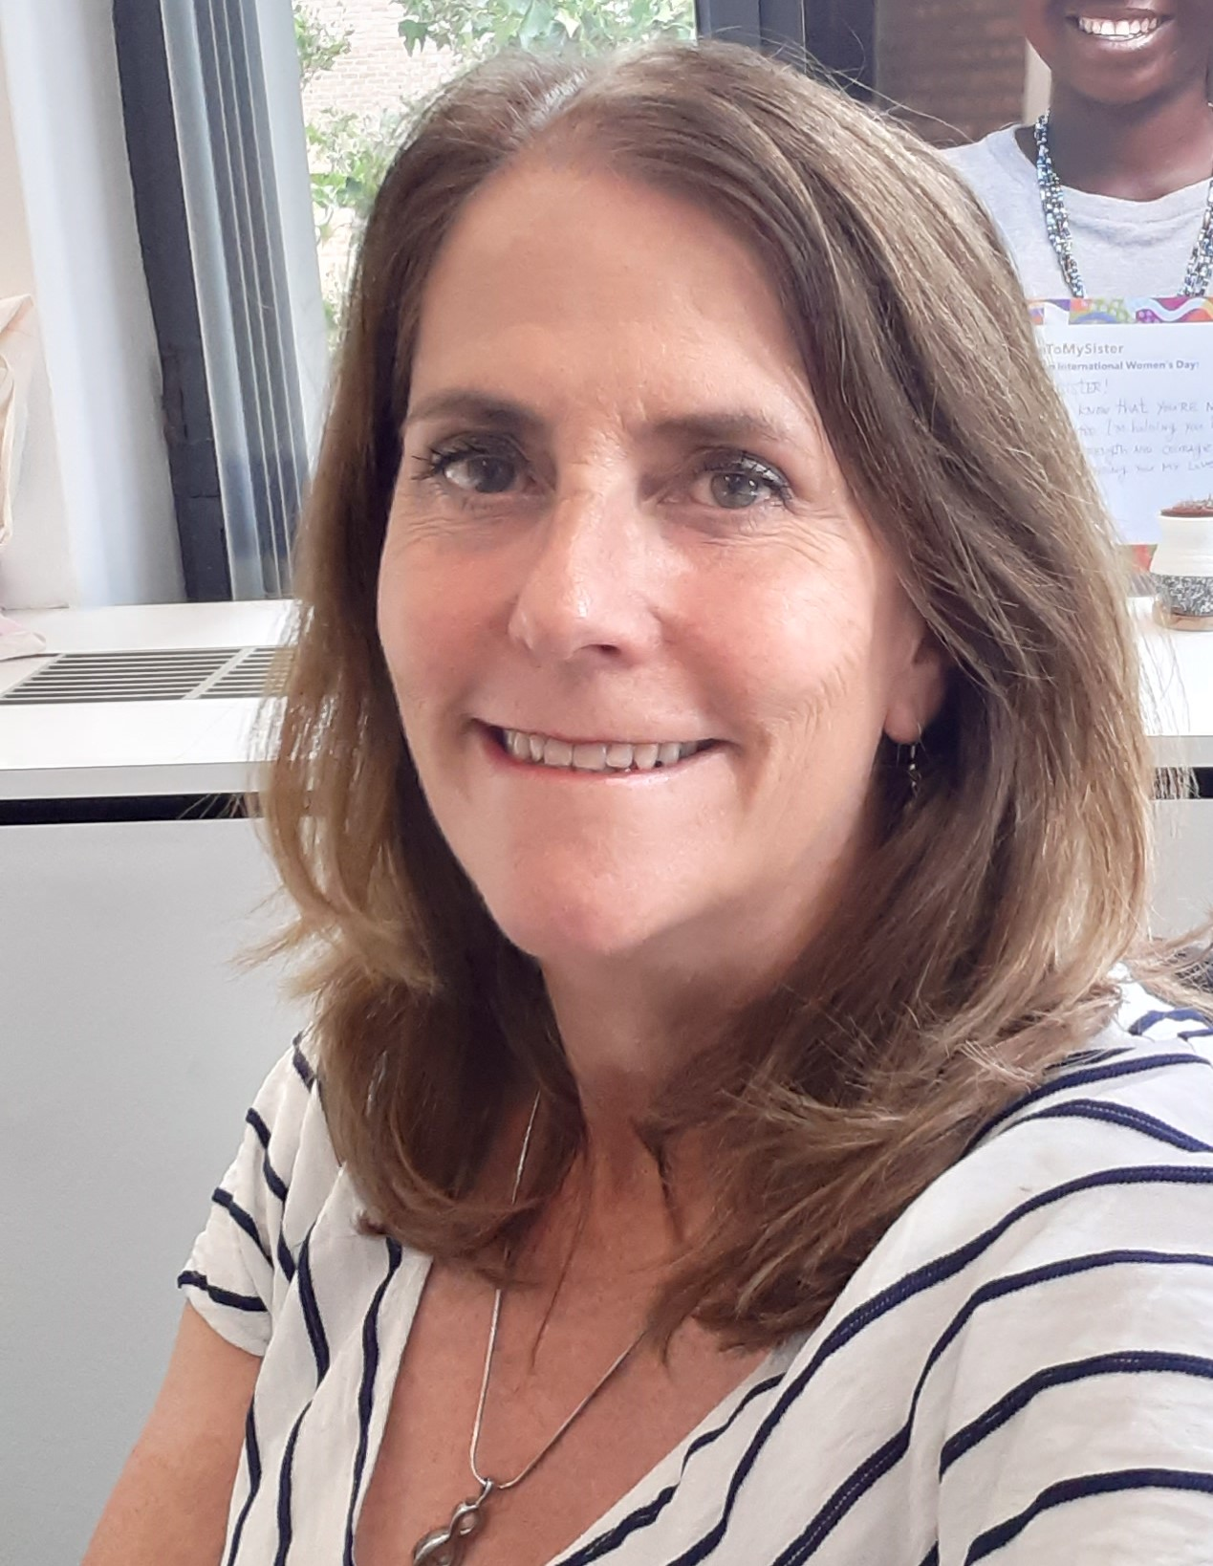
Our speakers
Bianca Valencia
Marketing & Communications Team
Birches Group
Warren Heaps
Partner
Birches Group
Beverly Stewart
Interim Global Director People, Capability & Culture
Women for Women International

Slide 3

What will we cover?
Workforce Under Pressure: How UK NGOs Navigated 2025
How the UK labor market changed in 2025
What this means for your compensation strategies in 2026
Organization Spotlight: Women for Women International
Q&A

Slide 4
Workforce under pressure: How UK NGOs navigated 2025
2025 brought difficult decisions for NGOs across the UK - restructuring teams, freezing pay, all while trying to stay true to mission and support staff through the uncertainty.
We conducted a survey to understand what those decisions looked like across organizations of different sizes and focus areas. Not just what changed, but what was retained, and how NGOs continue to navigate workforce management in unpredictable times.
Our survey explored three areas:
Workforce changes made — and whether they're still in place
How decisions were made — criteria, process, and communication
How organizations supported staff while keeping operations running
Fifteen responses were collected, predominantly from large international NGOs.

Slide 5
Restructuring was the norm, not the exception
The survey results show:
86%
have implemented some level of restructuring, including position elimination, layoff, reclassification, or redesign of roles
53%
have made changes in compensation and/or benefits, including freezing or reduction of salaries, allowances, benefits, and reduced work hours
53%
of organizations have paused promotions and learning and development activities
The changes are broadly consistent across location (e.g., headquarters, regional office, country office), employee groups (e.g., local and international staff), and grade level.

Slide 6
Changes to the workforce

Slide 7
Layoffs and organization or job redesign initiatives were widespread
Number of Organizations reporting restructuring initiatives (N=15)
Yes
No
No Response
46.7%
Furlough
40.0%
13.3%
80.0%
Layoff
13.3%
6.7%
86.7%
Org Redesign
6.7%
6.7%
80.0%
Job Redesign
13.3%
6.7%

Slide 8
Implementation of restructuring initiatives was carried out
Status of restructuring initiatives
Complete
In-process
Planned
Furloughs (85.7%) and layoffs (61.5%) were closest to completion
Broader organization and job redesign initiatives progressed more slowly
Furlough (N=7)
Layoff (N=13)
23.1%
Org Redesign (N=13)
7.7%
Job Redesign (N=12)
16.7%

Slide 9
Restructuring impacted all parts of the organization
Impact of restructuring initiatives on different parts of the organization
HQ
Regional
Country
Field
The impact of initiatives was broad
HQ and regional offices are impacted the most
The highest level of layoffs was at the HQ, regional, and country office levels
Furlough (N=7)
28.6%
Layoff (N=12)
Org Redesign (N=11)
Job Redesign (N=11)
Notes:
Organizations implemented initiatives in multiple parts of their organization
Initiatives applied equally to local and international (expat) staff

Slide 10
All employee groups except General (BG-1 – BG-3) were impacted by at least 50%
Impact of restructuring initiatives on different levels of the organization
General (BG-1 - BG-3)
Process (BG-4 - BG-7)
Design (BG-8 - BG-11)
Leadership (BG-12 - BG-14)
100.0%
100.0%
100.0%
91.7%
91.7%
91.7%
83.3%
83.3%
77.8%
75.0%
66.7%
66.7%
55.6%
58.3%
41.7%
22.2%
Furloughs
Layoffs
Org Redesign
Job Redesign

Slide 11
A wide range of criteria were used to determine layoffs
Criteria used for layoff determination (N=12)
Job
Job and location were the top criteria used, which made sense since the impact of cuts varied by location
Employee-specific criteria, such as performance or tenure, were less important
Program/work location
Employee performance ratings
Staff skills and qualifications
Tenure/seniority
Disciplinary records
Other

Slide 12
Statutory benefits were the most common approach to severance pay
Severance pay approaches (N=12)
Statutory severance pay and benefits only
Outplacement assistance
Continuation of employer-sponsored insurance
Referrals to aid job search
Voluntary Early Retirement Incentive
Mandatory Early Retirement Incentive
0
Other

Slide 13
Changes to pay and benefits

Slide 14
Most organizations were forced to make adjustments to compensation or benefits
Organizations reporting compensation and benefits changes (N=15)
Thirteen of fifteen organizations (86.7%) were forced to freeze or reduce compensation and benefits for staff
86.7%

Slide 15
Salary and benefits actions were applied equitably across the organization
Types of salary and benefit actions taken (N=13)
Salary Freeze
Salary freezes (54%) and benefits reduction (31%) were the most common actions taken
There was little or no variation in different parts of the organization
Actions were applied to different employee groups uniformly
Grade level was not considered in the application of adjustments
Benefits Reduction
Reduction of Work Hours
Salary Reduction
Allowance Freeze
Bonus Reduction
0
Bonus Elimination
0

Slide 16
Changes to staff development and engagement

Slide 17
Two-thirds of organizations froze employee development programs and promotions
Actions related to employee development and promotions (N=10)
Staff Learning & Development Programs
Staff promotions
Movement within Grade
Other
Half of the 10 organizations that took action halted learning and development programs or promotions

Slide 18
Organizations tried to maintain employee engagement activities
Status of employee engagement activities (N=13)
We have retained engagement activities related to health and well-being but scaled back on entertainment
We are not implementing any changes in the staff engagement program
We have eliminated all staff engagement activities for the current year
0
Other
No organization eliminated activities entirely
Most organizations applied only partial cutbacks

Slide 19
Communication, counseling, and peer support were the most common approaches to preventing burnout, demoralization, and weakened team dynamics
Approaches to support staff and prevent burnout (N=15)
Regular leadership communication (e.g., town halls, updates)
All but two organizations cited regular leadership communication
The top five approaches all emphasized communication between the organization and staff
Employee counseling was also mentioned frequently
Transparent explanation of restructuring decisions
Reaffirmation of organizational mission and goals
Employee counseling or mental health support
Increased manager check-ins or one-on-one meetings
Revised job descriptions or clarified roles
Flexible work arrangements (e.g., remote work, adjusted hours)
Anonymous feedback channels or pulse surveys
Team-building activities or workshops
Temporary workload redistribution or support staffing
Recognition and appreciation programs (non-monetary)
Opportunities for professional development or upskilling
Peer support or mentorship programs
Other (please specify)

Slide 20
Organizations took steps to ensure continuing services despite financial and operational challenges
Approaches to support staff and prevent burnout (N=15)
Restructured teams to ensure capacity for key program areas
Reprioritization of the programs
Review of compensation strategy, salary scales, and policies
Reduction in compensation budget
Tap into partnerships with other NGOs
Adopt new tools and technologies to maintain efficiency
Adopt flexible and remote work policies
Change the employment status of selected staff members to contractual, fractional or part-time
Full review of grading structure, job descriptions, and job classification
Implementation of learning and development activities to build back expertise and capacity
Tap volunteer networks to fill capacity gap
0
Other (please specify)

Slide 21
How the UK labor market changed in 2025

Slide 22
Our survey in the UK included 49 organizations in October 2025
350.org
38 Degrees
Abt Global
AIDS Healthcare Foundation
ARK Group DMCC
BirdLife International
BRAC Europe
C40
CAMFED
CBM International
Change.org
Children's Investment Fund Foundation (CIFF)
Climate Arc
Climate Policy Initiative
Clinton Health Access Initiative (CHAI)
Conservation International
Emergency Nutrition Network
Equality Now
GAIN
Girls Not Brides
GiveDirectly
Global Action to End Smoking
Global Energy Alliance for People and Planet (GEAPP)
Global Greengrants Fund
Human Rights Watch
International Committee of the Red Cross (ICRC)
International Crisis Group
International Planned Parenthood Federation (IPPF)
International Rescue Committee (IRC)
Kids in Need of Defense (KIND)
Light for the World
Management Sciences for Health (MSH)
MSI Reproductive Choices
Nguvu Collective
Norwegian Refugee Council (NRC)
Open Society Foundations (OSF)
Orbis International
Quadrature Climate Foundation (QCF)
Results for Development Institute (R4D)
Right To Play
Room to Read
Shell Foundation
VSO International
War Child Alliance
Well Grounded
Women for Women International
World Resources Institute (WRI)
World Vision International
World Wide Fund for Nature

Slide 23
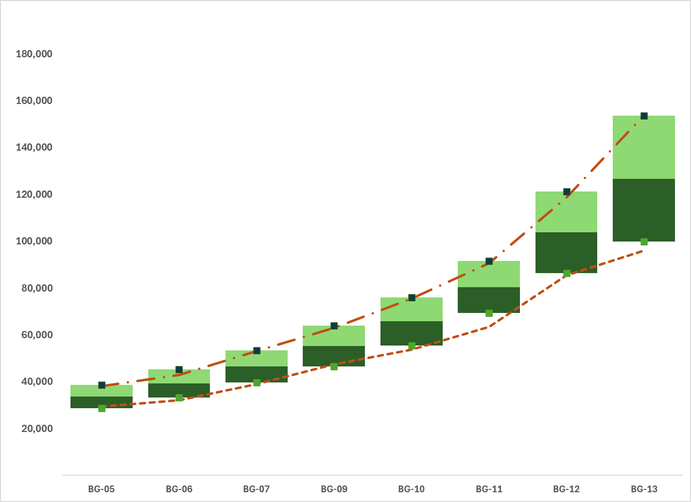
The total compensation from a constant sample in the UK survey grew just under 2% from 2024 to 2025
Total compensation by BG Level, United Kingdom (constant sample)
2024 vs 2025
2025 vs 2024
Many organizations froze pay in 2025
Pay growth averaged 1.9%
+1.9%
Source: Birches Group NGO Local Pay Survey, October 2025

Slide 24
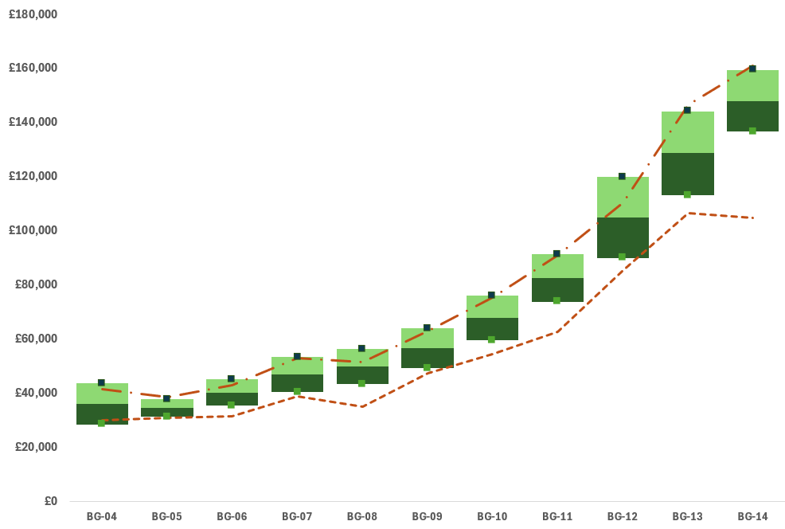
The overall NGO survey results in the UK grew 5.11% from 2024 to 2025
Total compensation by BG Level, United Kingdom
2024 vs 2025
2025 vs 2024
Senior support staff roles (BG-6, BG-7) grew 6.8%
Professionals at BG-9 and BG-10 grew 3.9%
Year on year data indicates the typical minimum increased in most grade levels
Increases in the maximum are notable at BG-12
While BG-14 increase at minimum is high, this is due to a limited number of data points
6.8% average increase
3.9% average increase
+5.11%
Source: Birches Group NGO Local Pay Survey, October 2025

Slide 25
Non-salary elements are an important part of total compensation
Percent of UK NGOs offering non-salary elements of total compensation
(N=49)
Common in-kind benefits include food and beverages (29%) and recreational activities (22%)
Short-term incentives are offered by 16% of organizations
Less common were loan benefits, fixed bonus, transportation and housing
Miscellaneous are predominately related to remote or hybrid work arrangements
Food & Beverages
Recreation
Short-term Incentives
Loan Benefits
Fixed Bonus
Transportation
Housing
Miscellaneous
Source: Birches Group NGO Local Pay Survey, October 2025

Slide 26

2026 will be another challenging year
Compensation Strategy & Talent Management
INFORMED, DEFENSIBLE RECRUITMENT DECISIONS
Use market data to develop offers based on market realities, avoiding guesswork and potentially overpaying or losing candidates
AVOID BLANKET FREEZES
Ensure that your organization stays abreast of market conditions and adjust your pay scale accordingly
DESIGN COMPETITIVE TOTAL REWARDS
When salary increases aren't feasible, market data shows what other organizations are offering through non-salary elements to stay competitive without raising base pay

Slide 27

Anticipate your budgetary challenges
Budget Forecasting & Financial Planning
BUILD CREDIBLE COMPENSATION BUDGETS
Model best-case, moderate, and conservative scenarios tied to different funding outcomes. Market data should be used to inform these models.
ANTICIPATE FUTURE COMPENSATION PRESSURE
Tracking market trends over time allows organizations to get ahead of salary increases before they become retention crises
WORK CLOSELY WITH FINANCE
HR and Finance need to work in close coordination to develop budgets reflecting the realities of the market

Slide 28

Manage donor and stakeholder engagement proactively
Stakeholder & Donor Engagement
JUSTIFY COMPENSATION COSTS TO FUNDERS WITH NUMBERS, NOT NARRATIVES
‘Our program manager is at the 50th percentile of our target market' is far more compelling than 'our staff is experienced and hardworking.’
PROACTIVELY ADDRESS FUNDER SCRUTINY
Identify data which supports your funding request, and incorporate it into your communications with donors
BUILD BOARD CONFIDENCE IN HR DECISIONS
Leadership and boards are more likely to support compensation investments when they are grounded in external market evidence

Slide 29

In 2026 and beyond, there will be more scrutiny on pay equity
Equity, Consistency & Internal Fairness
ADVANCING PAY EQUITY & TRANSPARENCY COMPLIANCE
Leverage market data to comply with the Equal Pay Act (2010) and evolving transparency laws, ensuring fair, objective compensation based on the cost of labor
MAINTAIN STAFF TRUST DURING UNCERTAINTY
Demonstrate the use of a data-based logic rather than favoritism or budget panic in order to maintain morale and trust amongst staff
CORRECT COMPRESSION ISSUES PROACTIVELY
Consider using tools such as Birches Group Community™ Skills to assess experience and knowledge, and linking these assessments to pay progression
PROVIDE A CONSISTENT FRAMEWORK FOR MANAGERS
HR needs to support managers actively in the conduct of pay discussions with staff

Slide 30



Ou min
UK Case Study on Birches October 2025 NGO Salary Survey

Slide 31


Birches Full NGO October 2025 Findings
Evidence: Birches Oct 2025, full UK NGO sample.
WfWI’s Pay Philosophy is targeted around the 50th percentile market position.
We found WfWI UK is behind the market 50th percentile by 13.70% on average (positive values indicate the market is ahead).
Range competitiveness: WfWI is positioned around the 28th percentile at minima and the 22nd percentile at maxima, indicating the gap is not only at entry, but compounds at more experienced levels.
Why maxima matter: when the top of the range sits materially below market, it weakens the “long-term value” proposition for experienced staff and can restrict credible progression within grade, raising the likelihood of external moves.
Notes:
Internal evidence: UK turnover and retention risk
The UK office has a higher turnover rate than other offices and the organizational average. This is consistent with staff mobility driven by pay competitiveness and indicates a real risk of continued losses if we do not address structural misalignment.
Recruitment costs: advertising, agency/search fees, interview time Onboarding/training costs: induction, training time, manager/HR time Vacancy costs: work not done, slower delivery, overtime/temporary cover Productivity loss: ramp-up time until the replacement is fully effective Knowledge/relationship loss: loss of expertise, stakeholder relationships, continuity

Slide 32
Key WfWI – UK Risks: Turnover, Retention and Operational Disruption
In 2025 UK’s turnover was higher than other WfWI offices and the organisational average.
WfWI UK is not reliably holding the intended 50th percentile position, with the most concern at the top end of ranges (maxima) and in the broader market view.
This is consistent with staff mobility driven by pay competitiveness and indicates a real risk of continued losses if we do not address structural misalignment.
This explains retention rates and hiring pressures in the UK Office.
The impact it had was that vacancies and hiring delays reduce continuity, especially in specialist roles.
High turnover drives recruitment fees, onboarding time, productivity loss, and leadership time.

Slide 33
Financial and Risk Management Considerations (with 2025 and 2026 salary constraints)
2025 context: salary and promotion freeze limited progression and widened market drift.
Risk trade-off: holding pay flat can reduce cost short-term, but increases attrition risk.
Cost lens: model payroll impact alongside vacancy time, backfill, and ramp-up costs.
Equity risk: manage compression and keep staff within bands for their grade.
Stage implementation if needed (for example, apply lowest-paid and below-band staff first), while keeping the structure approved for the full adjustment plan.
Mitigations: Monitor UK retention and hiring outcomes in UK after implementation.
Notes:
Financial and risk management considerations
We recognize current financial constraints and the use of salary freezes. This proposal is framed as a targeted correction in the office with the clearest market drift and retention signal.
“Attrition costs” means the total costs the organisation incurs when employees leave (attrition = staff exits/turnover).
Key risk mitigations:
Use clear rules to avoid pay compression and inconsistent outcomes.
Stage implementation if needed (for example, apply lowest-paid and below-band staff first), while keeping the structure approved for the full adjustment plan.
Monitor retention and hiring outcomes in the UK after implementation.

Slide 34
Implications for 2026 Compensation Strategy
How our pay, benefits and total reward approach has evolved:
We have agreed on paying around the 50th percentile, and the Birches benchmarking has made the degree of “drift” visible and quantifiable (e.g., the Oct 2025 full market view).
In 2025 and currently 2026, the organisation is operating under salary constraint measures, including a salary and promotion freeze, shifting focus from annual increases to maintaining fairness, affordability, and transparency under tighter conditions.
Rather than a general cost-of-living adjustment across offices, the approach described here frames pay action as a targeted exception for the UK where external drift and internal turnover signals align.
Adopting the 2025 - 2026 UK salary scale and applying consistent band rules strengthens how pay is set, progressed, and governed, reducing ad hoc outcomes and supporting internal equity.
The 2026 planning linkages (talent management, fundraising strategy, and budget forecasting) position compensation as one part of the broader value proposition, supporting retention through clearer progression, workforce stability, and delivery capacity (in addition to base pay levels).

Slide 35
Implications for 2026 Compensation Strategy
These shifts provide the context for the 2026 implications below:
Treat the 50th percentile philosophy as the reference point for UK ranges and incumbent positioning, making explicit how the organisation will interpret “around 50th” (e.g., acceptable variance) in a constrained environment.
As the October 2025 full market view shows the greatest concern at range maxima, 2026 planning needs to preserve credible within, grade progression (so experienced staff are not forced to exit the organisation to realise market value).
Budget forecast and scenario planning: reflect UK salary scale adoption and any incumbent alignment costs in the 2026 budget forecast, and stress-test affordability under different income scenarios.
Fundraising strategy linkage: use the new fundraising strategy to articulate how stabilising UK capability reduces delivery risk, improves capacity planning, and protects income-generation activities (e.g., reducing repeated backfill cycles in key roles).
Talent management integration: after a 2025/2026 Quarter 1 salary/promotion freeze, 2026 needs a clear approach to progression signals (development, internal mobility, promotion readiness) that aligns with updated ranges and avoids over-reliance on counter-offers.
Workforce risk dashboard: define the metrics leadership will review through 2026 to ensure pay strategy is reducing risk (UK turnover trend vs baseline, time-to-fill, acceptance rates, and distribution of staff within bands).

Slide 36

Thank You!!!

Slide 37
Q&A

Slide 38
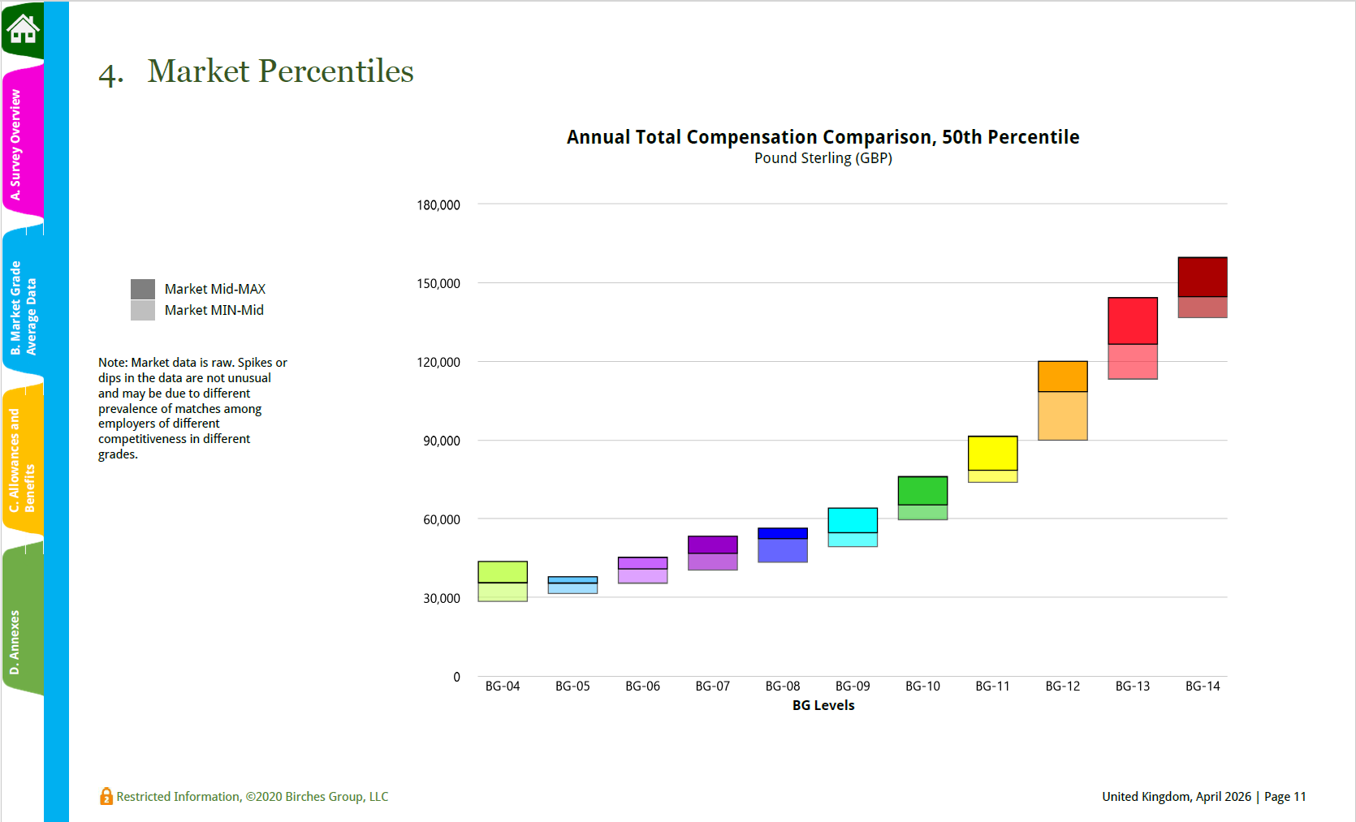
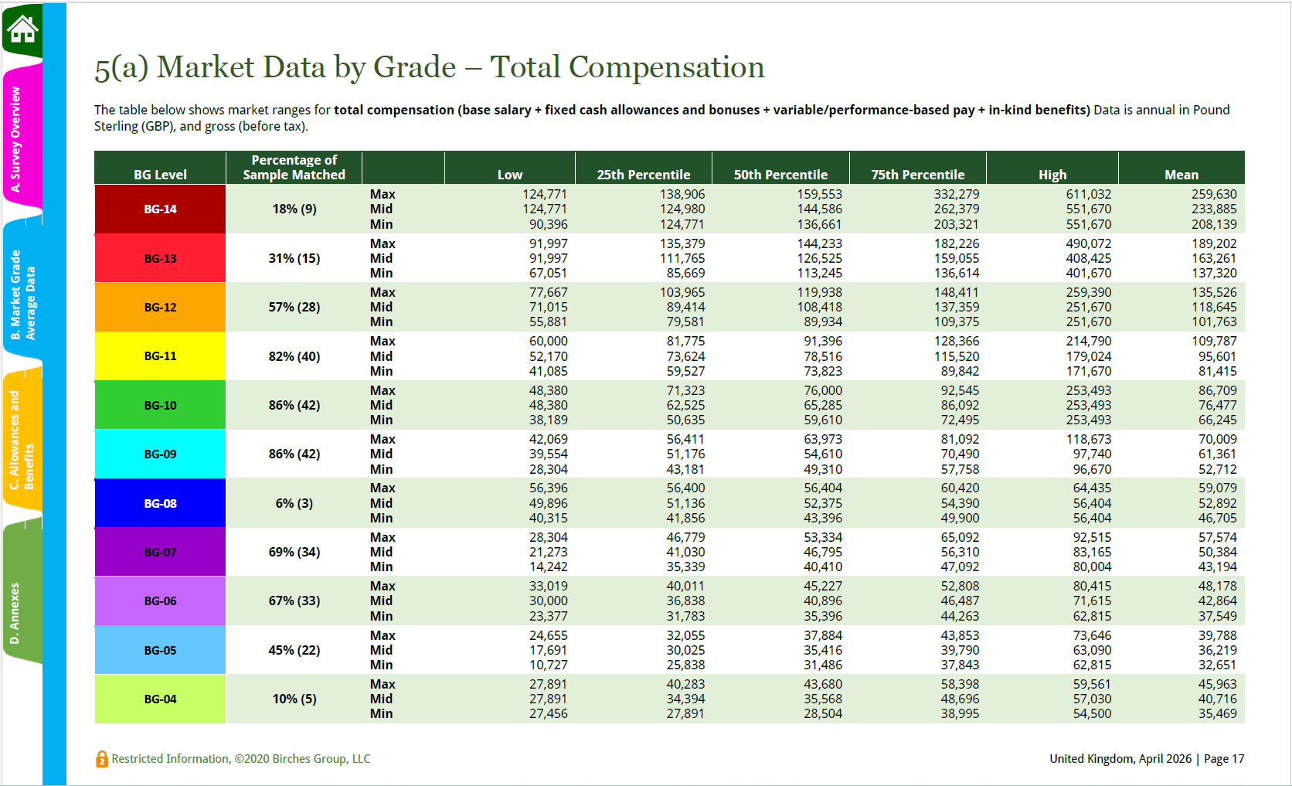
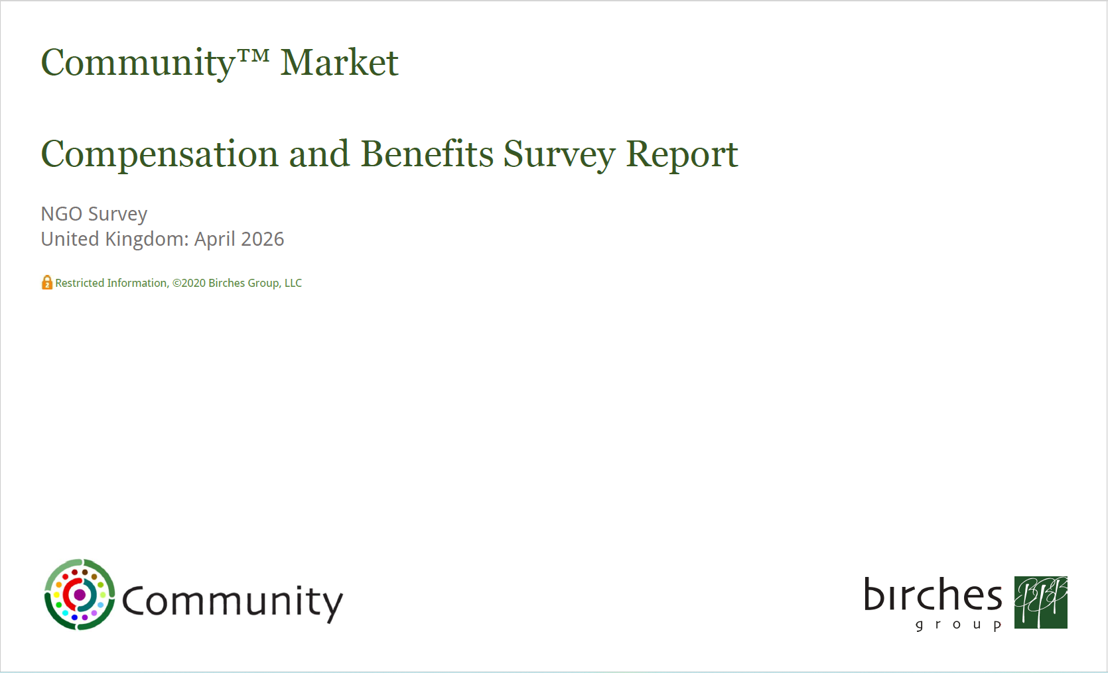
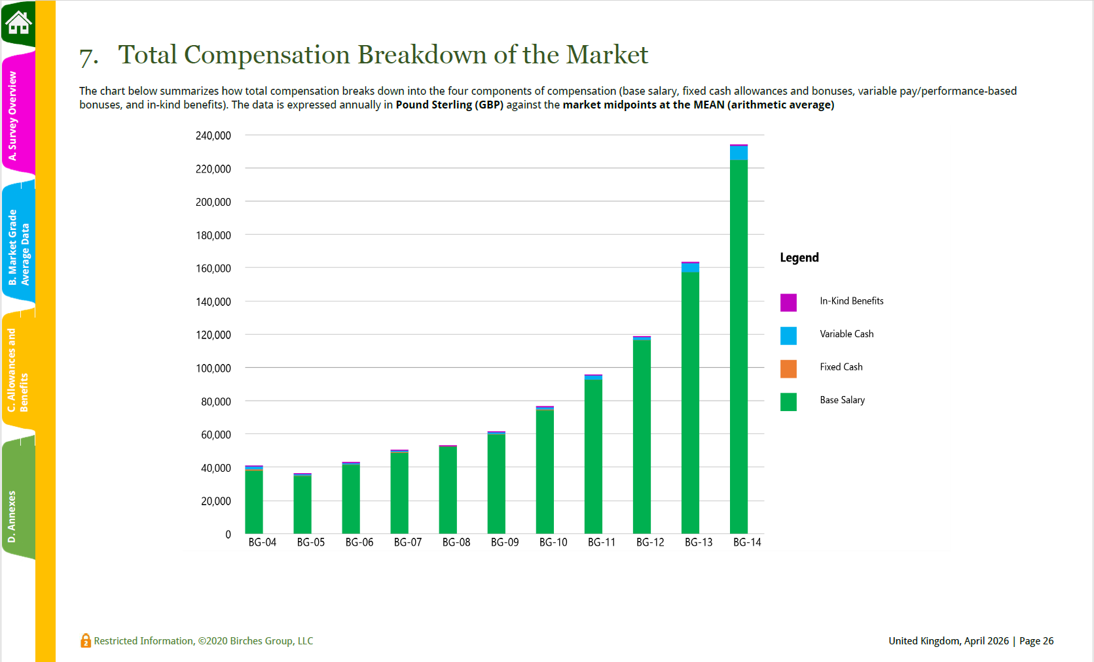
Our April 2026 UK NGO Survey results will be available next month!
If you’d like to participate and get access to our latest survey results, email info@birchesgroup.com or contact Bond.
Bond members participating for the first time can enjoy a 10% discount on subscription fees!

