Slide 1

Protected Beliefs & the Right to Freedom of Expression: legal Insights for NGOs
Pippa Garland and Carla whalen

Slide 2
What we’ll cover (and why)
Current climate – global, UK, and NGO sector
Recent case law – what approach do the courts expect you to take?
Governance and regulatory – what approach does the Charity Commission expect you to take?
Practical – what can you do to manage risk and be ready for challenge?

Slide 3

Legal protections and their limits
Equality Act 2010
Belief is a protected characteristic – any religious or philosophical belief (including lack of belief)
Protection from discrimination, harassment, victimisation
ECHR
Article 9(1) – absolute right to hold a belief
Article 9(2) – manifestation of that belief may be restricted
Human Rights Act

Slide 4

Recent case law – manifestation
Higgs v Farmor's School [2025] EWCA Civ 109
Christian employed by secondary school
Dismissal for social media activity resulting in complaint
UK Equality Act 2010 must be interpreted (as far as possible) to give effect to ECHR rights and freedoms
No right not to be offended – high bar for the manifestation of a belief to be objectionable in law
Emphasis on balancing rights and proportionality

Slide 5
Recent case law – manifestation
Bailey v Stonewall and others ET/2202172/2022
Barrister suffered direct discrimination when her chambers posted online that it would investigate her Tweets
Victimisation by chambers following Tweets which were protected acts
Claims against Stonewall for making a complaint about Ms Bailey to her chambers rejected (Bailey v Stonewall Equality Ltd [2025] EWCA Civ 1662)

Slide 6
Recent case law – manifestation
Smith v Manchester City Council [2025] EWHC 2987
Evangelical Christian couple’s fostering application rejected because they believed homosexuality and abortion were wrong and held gender critical views
Council had concerns they would find it difficult to promote diversity
High Court – not direct discrimination or breach of Convention rights; objectively justifiable response to the way the couple said they would manifest their beliefs

Slide 7
Recent case law – manifestation
Adams v Edinburgh Rape Crisis Centre [2024] 5 WLUK 564
Employee dismissed for response when service user queried the gender of a colleague
Summary dismissal for gross misconduct
Finding of harassment and direct discrimination

Slide 8
Recent case law – facilities/services
For Women Scotland Ltd v Scottish Ministers [2025] UKSC 16 – “sex”, “woman”, “man” in the Equality Act 2010 refers to “biological sex”
Kelly v Leonardo UK Ltd (ET) – toilet access policy
Peggie v Fife Health Board (ET) – changing room policy
Hutchinson and others v County Durham and Darlington NHS Foundation Trust (ET) – changing room policy

Slide 9

Putting FWS into practice
EHRC Code of Practice for services, public functions and associations (Services Code)
May 2025 – further consultation
Sept 2025 – submitted to government
Jan 2026 – David Holdsworth (Chief Executive, Charity Commission) responds to open letter; Guardian reports draft Code being adapted following appointment of new EHRC Chair

Slide 10
Putting FWS into practice
Girlguiding
… it is with a heavy heart that we are announcing trans girls and young women will no longer be able to join Girlguiding. This is a decision we would have preferred not to make…
National Federation of Women’s Institutes
It is with the utmost regret and sadness that we must announce that, from April 2026, we can no longer offer formal membership to transgender women. As an organisation that has proudly welcomed transgender women into our membership for more than 40 years, this is not something we would do unless we felt that we had no other choice
Hampstead ponds – consultation responses (over 38,000) overwhelmingly favour current trans-inclusive approach; City Corporation to make final decision

Slide 11

NGOs in the spotlight
NGOs in the headlines
Pressure and intimidation
Co-ordinated complaints
Open letters
Litigation threats
Social media pile-ons

Slide 12
Charity Commission’s involvement
Complaints
“This is our promise to the public: we assess every concern that comes to us. No complaint will be dismissed out of hand, no concern is ignored. But we refuse to be dragged into complaints that seek to weaponise the legitimate work of charities. Our job is to uphold charity law, the laws a democratically elected Parliament has passed.”
(Mark Simms OBE, Chair of the Charity Commission Annual Public Meeting 2025)
“Every concern raised with us is examined. No complaint within our remit is dismissed.”
(David Holdsworth, CEO, Charity Commission Annual Public Meeting 2025)
Serious incident reports
Media response

Slide 13
Charity Commission’s approach
Acting within the charity’s objects
Decision making process
Managing conflicts

Slide 14
Practical steps
Governance and people
Training
Code of conduct
Policies and communication
Social media policy
Communications framework for external statements
Consistency across issues and conflicts
Positioning
Clear public articulation of charity’s remits and limits
Setting expectations early

Slide 15
Final thoughts
Risk management not elimination
Silence not required
No neutral ground

Slide 16

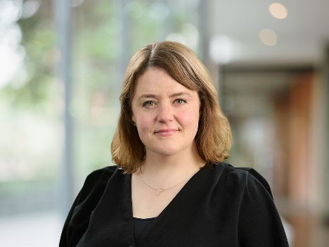
Pippa Garland
Carla Whalen
Partner
Partner
0208394 6491
0208394 6419
Pippa.Garland@russell-cooke.co.uk
Carla.Whalen@russell-cooke.co.uk

