Slide 1
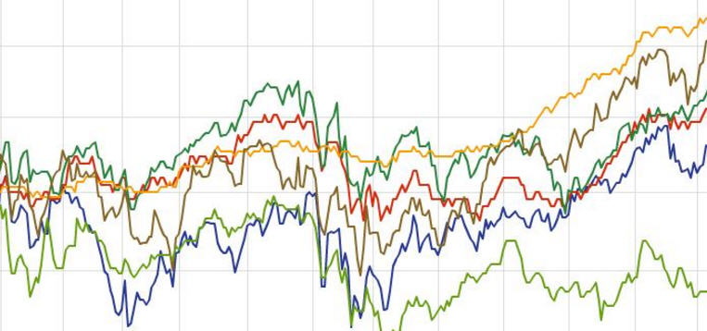
Managing Compensation in Volatile Economic Conditions
October 9, 2025
Bond Webinar

Slide 2
Today we will be discussing how to manage compensation under volatile economic conditions
We will learn about:
Key concepts about how pay is established, and how economic volatility impacts it
Deep Dive – Ethiopia: A more detailed look at the market in Ethiopia
Optimal solutions: A Policy Driven Approach
Dollarization: Don’t Do It!
Addressing other types of volatility: Natural disasters, civil unrest
Q & A

Slide 3

How should employers set pay?
According to cost of living in the country?
According to headquarters pay, adjusted by foreign exchange?
Based on what’s advertised for jobs with similar titles in country? Or in neighboring countries?
Using data obtained by calling friends who used to work in that country 3 years ago?
Based on relevant market data
In accordance with a documented compensation philosophy
Within the limits of the employer’s budget
Using a cost of labor approach

Slide 4


How should employers set pay?
According to cost of living in the country?
According to headquarters pay, adjusted by foreign exchange?
Based on what’s advertised for jobs with similar titles in country? Or in neighboring countries?
Using data obtained by calling friends who used to work in that country 3 years ago?
Based on relevant market data
In accordance with a documented compensation philosophy
Within the limits of the employer’s budget
Using a cost of labor approach
Setting pay should be based on a compensation philosophy, which identifies the specific, relevant market in which the employer competes for talent, and the market position targeted against that market.
Pay (usually) gets adjusted according to market movement; i.e., how much the target market moves each year.
Market movement is independent from cost of living (inflation) and currency devaluation. It is heavily influenced by supply and demand of talent in a market.
In developing markets, especially smaller ones, it can be a challenge to find the right talent, particularly experienced professionals and managers. The supply and demand for such talent is often very competitive.

Slide 5
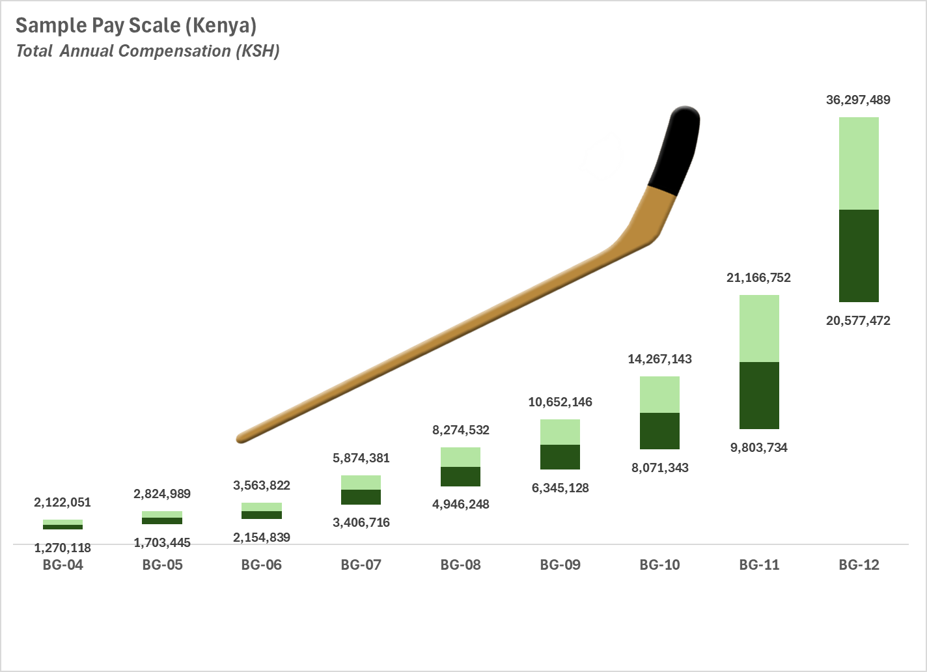
In a developing country, the pay curve resembles a hockey stick
84% midpoint difference
The difference from level to level is much higher for professional and manager levels compared to support roles
For example:
BG-6 midpoint is 26% higher than BG-5
BG-12 midpoint is 84% higher than BG-11
Note this is raw data from 2023
A proper employer salary structure would smooth out some of the irregularities
26% midpoint difference

Slide 6
When economic volatility strikes, compensation management needs to adapt – it’s not business as usual

Slide 7
When high inflation or devaluation occurs, it impacts all stakeholders
Inflation
Measures the increase in cost of living
Typically issued by government statistics bureau
Market basket approach measures prices in country over time
Government statistics often unreliable; hard to get good data
Impact on NGOs
Donor budgets are fixed
Impact on price of local goods and supplies, especially imported items
Compensation increases over time
Impact on Staff
Desire to be kept “whole”
Concern about ability to maintain their standard of living
Can they afford staple items for their family?
Look to employer to help

Slide 8
When high inflation or devaluation occurs, it impacts all stakeholders
Inflation
Measures the increase in cost of living
Typically issued by government statistics bureau
Market basket approach measures prices in country over time
Government statistics often unreliable; hard to get good data
Devaluation
Measures currency exchange rates, typically versus USD or other hard currency
Currency markets are volatile and react to many factors including political ones
Exchange rates are widely available on a current basis
Impact on NGOs
Donor budgets are fixed
Impact on price of local goods and supplies, especially imported items
Compensation increases over time
Impact on NGOs
Impact (positive and negative) on hard currency budgets
Increase in price for imported raw materials
Supply of hard currency through banking system
Impact on Staff
Desire to be kept “whole”
Concern about ability to maintain their standard of living
Can they afford staple items for their family?
Look to employer to help
Impact on Staff
Making less in hard currency terms (does that really matter?)
Imported goods will increase in price
Ability to cover offshore expenses
Will seek in-kind benefits rather than currency (keeps value)

Slide 9

Deep Dive: Ethiopia
Image: By Drawn by User:SKopp - http://www.ethiopar.net/type/Amharic/hopre/bills/1998/654.ae..pdf (Unreachable) User:Lin Kuei Warriors, Public Domain, https://commons.wikimedia.org/w/index.php?curid=343048

Slide 10
Ethiopia has a long history of currency volatility
Exchange Rate History
1 USD:ETB
2015 - 2025
YTD 2025 (monthly)
2024 (monthly)
+15.6%
+122.7%
Historically, devaluation averaged about 20% per year
2015 – 2023 (8 Years)
(average for the year)
+161.7%
78
2024 was a very challenging year from July
Devaluation was almost as great as the prior 8 years combined
2025 has been relatively stable
2015
2016
2017
2018
2019
2020
2021
2022
2023
Jan
Feb
Mar
Apr
May
Jun
Jul
Aug
Sep
Oct
Nov
Dec
Jan
Feb
Mar
Apr
May
Jun
Jul
Aug
Sep
Oct

Slide 11
Inflation is high, causing purchasing power to deteriorate
Annual Inflation Rate - Ethiopia
2015 - 2025
2015
2016
2017
2018
2019
2020
2021
2022
2023
2024E
2025E
Source: OECD Database

Slide 12
Typically, inflation and devaluation don’t differ much, though devaluation is often a leading indicator
Inflation and Devaluation in Ethiopia
2015 - 2025
Inflation (%)
Devaluation (%)
Over the last four years, Ethiopia has been one of the most challenging African markets
In 2022 and 2023, inflation substantially exceeded devaluation, by 16.3% and 24.8% respectively
In 2024, the pattern reversed (32.2%)
2015
2016
2017
2018
2019
2020
2021
2022
2023
2024E
2025E

Slide 13
What did the market do from 2024 to 2025?
Economic Indicators:
Inflation: 21.5% in 2025 26.4% from 2023-2025
Devaluation: 15.6% in 2025 147% from 2023-2025
Observations:
Cumulative market movement for support staff over 2023-2025 period in the multisector market matches devaluation
Professional market movement in the same period covered about two-thirds of devaluation
NGO market movement for professionals approximately matched inflation in 2025 (vs 2024)
For NGO support staff, market movement was slightly higher
Market Movement – Ethiopia
Average Percent Increase - 2024 to 2025
Professionals
Support Staff
NGO (Local Currency)
Hard Currency (NGO)
Multisector (’24-’25)
Multisector (’23-’25)

Slide 14
It is clear labor markets move independently from inflation and devaluation

Slide 15
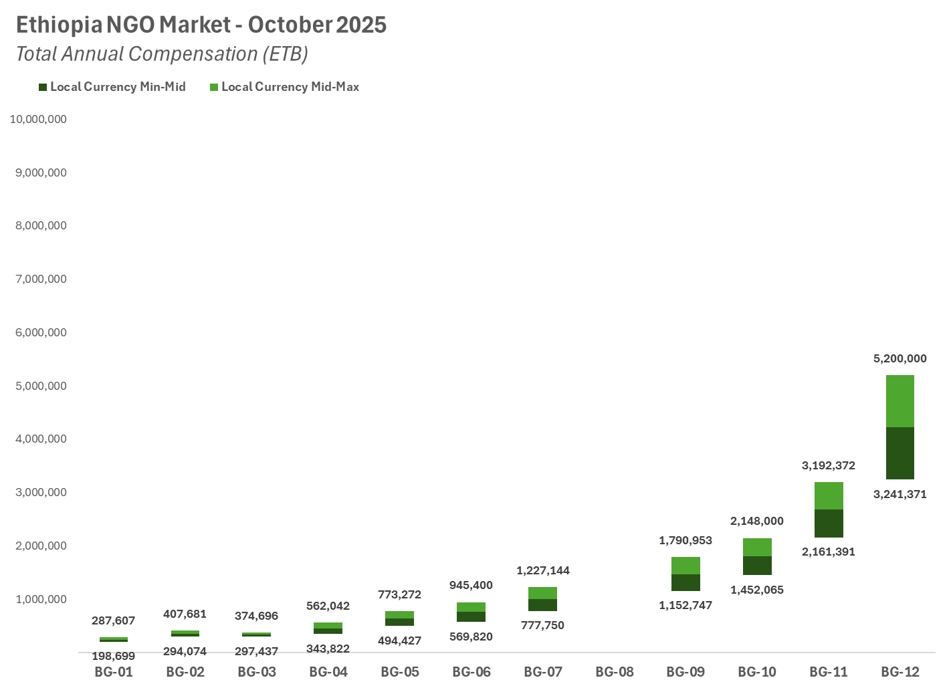
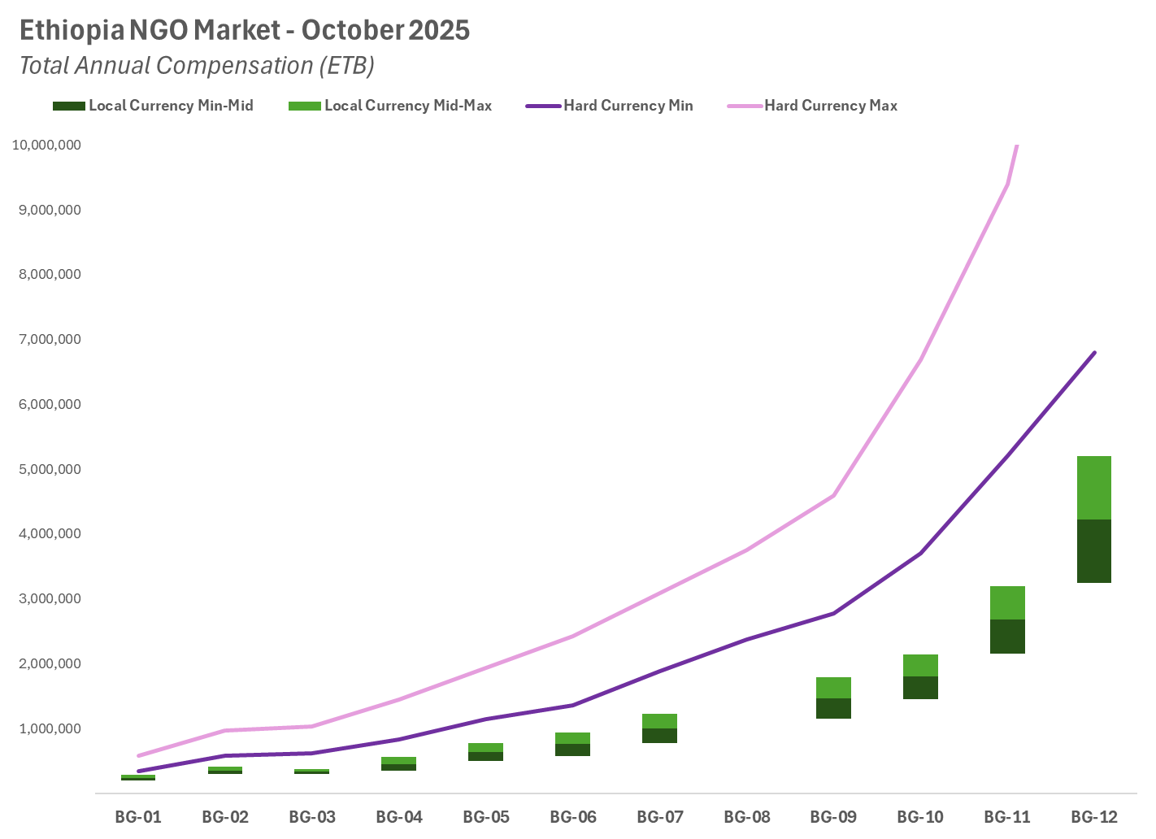
Currently, the NGO market in Ethiopia is bifurcated due to the large number of employers adopting hard currency to set salaries
This graph shows salary range for employers denominating in Birr
The salary range for hard currency denominated employers is shown in pink and purple
35 employers
37.2% of the market
59 employers
62.8% of the market
Source: Birches Group LLC NGO Local Pay Survey in Ethiopia, October 2025

Slide 16
There are now two distinct markets for NGOs in Ethiopia
Level | Minimum Local Currency | Minimum Hard Currency | Percent Difference | Maximum Local Currency | Maximum Hard Currency | Percent Difference
BG-6 | 569,820 | 1,363,679 | 139.3% | 945,400 | 2,422,622 | 156.3%
BG-9 | 1,152,747 | 2,774,556 | 140.7% | 1,790,953 | 4,598,160 | 156.7%
BG-10 | 1,452,065 | 3,703,998 | 155.1% | 2,148,000 | 6,684,201 | 211.2%
BG-11 | 2,161,391 | 5,206,754 | 140.9% | 3,192,372 | 9,390,425 | 194.2%
BG-12 | 3,241,371 | 6,800,642 | 109.8% | 5,200,000 | 10,927,024 | 189.5%
Average difference at minimum is 137.2%
Average difference at maximum is 181.6%
It is nearly impossible for local currency-based employers to compete against their hard currency-based competitors

Slide 17
What happens when the situation is unstable due to economic volatility?

Slide 18

What usually happens when there is a crisis
I wonder what I should do about the crisis?
What are YOU doing about the devaluation?
What are you doing about the crisis?

Slide 19
You need a policy-driven approach

Slide 20
“Special Measures” policies provide consistent and fast responses to crisis situations
Goals of a Special Measures policy are to:
Maintain office operations
Address staff anxiety
Demonstrate responsiveness which is responsible
Maintain linkage to established pay policies
Respond quickly to the situation on the ground

Slide 21
“Special Measures” policies provide consistent and fast responses to crisis situations
Goals of a Special Measures policy are to:
Maintain office operations
Address staff anxiety
Demonstrate responsiveness which is responsible
Maintain linkage to established pay policies
Respond quickly to the situation on the ground
Benefits of a Special Measures policy:
Sets precedent for later and other countries
Sensitive to:
Resource constraints
Linked to the market
Community image
Allows organization to act quickly without lengthy approvals
Has an exit strategy

Slide 22
How to Establish Special Measures
Define a Trigger Point
Define a Response
Set a Timeframe and Monitor
Plan Your Exit

Slide 23
Set a Trigger Point
Significant devaluation
Example: Minimally 40% within a six-month period accompanied by price spikes in basic commodities such as food
High inflation
Example: 50% devaluation at one time, or inflation above 20% per month for three consecutive months
Consider what data source you will use
Devaluation is a leading economic indicator and data is freely available
Inflation is a lagging indicator, and it is difficult to get updated data that is accurate

Slide 24
Define Your Response
Temporary allowance of 25% of devaluation
Immediate payment
Always consider market position when setting temporary allowance

Slide 25
Monitor the Market
Check market movement regularly
As more employers respond to the crisis, market will start to move up
Periodically, say every three months, decide if you should convert some or all of Special Measures allowance to regular salary
Always consider your competitive market position

Slide 26
Winding Down
Market has caught up or overtaken the amount of Special Measures Allowance
Convert Special Measures Allowance to regular salary and end the allowance
Always consider your competitive market position

Slide 27
Special Measures Allowance Lifecycle
Trigger is Reached
25% of the trigger amount is established as a special measures allowance
Market Monitoring
During the next 3-6 months, monitor market movement
Market Exceeds Special Measures
When market movement occurs, increase base salary and reduce allowance in equal amounts
Roll into salary
Eliminate allowance
Take your market position into account and adjust accordingly

Slide 28
Remember: The Hard Realities about Special Measures
What is granted cannot be taken away or reduced; at best it can be frozen
It is impossible to tailor measures for individual staff to address different personal situations or needs

Slide 29
Communication and Clarity
Employees want to know what they can count on from their employer
Employees understand that their employer cannot necessarily “keep them whole,” despite what they may ask for
Managers and employees alike appreciate the clarity a clear policy provides

Slide 30
Regular Communication is Key
Advise staff of measures taken at each stage to demonstrate responsiveness
Remind managers and staff about the policy provisions
Be empathetic to their financial pain
Emphasize a continuing link to the labor market

Slide 31
Clients Often Ask: Should We Pay in Hard Currency*?
*Hard currency is US dollars, UK Pounds, Euros, and other global reference currencies

Slide 32
No!
לא!
Nej!
¡No!
Hakuna!
لا!
In any language, the answer is no!
不！
Não!
Non!
Нет!
Nee!
ไม่!
Nein!

Slide 33
Local Staff Should be Paid in Local Currency
Unless
It is supported by comparator practice
There is no functioning local currency
Caution
Paying in foreign currency in some countries is illegal
Staff may be at risk if they participate in black market transactions

Slide 34
Switching to Hard Currency
Pro
Easy to start
Simple to explain
Con
Difficult to set exchange rate
Local currency could revalue
Creates a mindset which separates local staff from the local economy
Puts your budget controls in the hands of the exchange rate gods
Difficult to end (switch back to local currency)

Slide 35
You can potentially lose control of your budget if you adopt hard currency salaries
Impact of changing a salary of ETB 5,000,000 to USD 64,500 on July 1, 2024
Payment converted using monthly exchange rate
Due to the devaluation, the salary increased 87.1% in local currency equivalent over a period of 15 months
This excludes any annual merit increase for which the employee would likely be eligible
During the same period, the average increase (due to market movement) for professionals was between 20% and 25%
Because of dollarization, your salary increase is more than 3X compared to the market
+87.1%
Jul-24
Aug-24
Sep-24
Oct-24
Nov-24
Dec-24
Jan-25
Feb-25
Mar-25
Apr-25
May-25
Jun-25
Jul-25
Aug-25
Sep-25
Oct-25

Slide 36
Special Measures for other types of crises
Organizations can use a special measures approach to address other unexpected events, such as:
Natural disasters
Civil unrest
Other emergencies or disruptions

Slide 37
The Importance of Clarity
As an employer, it is the labor market that determines the level of pay
Special Measures are temporary and supplemental, not a replacement for labor market comparisons
Goal is stabilization, not insulation
Special Measures demonstrates your willingness as an employer to respond within the constraints of resources and sensitivity to the broader context
Clear communications are essential

Slide 38
In summary
Operating in volatile economies presents new challenges
NGOs should pay careful attention to labor market movement rather than inflation/devaluation “noise”
Policy, not ad-hoc
A policy-driven approach promotes transparency and reassures staff that the company will help when necessary, without sacrificing a market-driven basis for compensation
Market intelligence is key
You need reliable data, especially in the most dynamic global markets

Slide 39
Additional resources
Birches Group Market Monitor
A bi-monthly update on economic conditions around the world
Free, but you must subscribe here: Register for Market Monitor
2025 Compensation and Benefits Survey for the UK and in Over 150 Countries Globally
Bond members can enjoy a 10% discount on survey fees
To avail your discount, send us an email and tell us you’re a member of Bond!
Contact us: info@birchesgroup.com www.birchesgroup.com

Slide 40

More Birches Group Community™ Solutions
Birches Group’s Community™ platform delivers an integrated workforce management solution that connects jobs to people, links development to performance, and addresses complex workforce challenges—all within a simple, powerful, and cohesive framework.
Jobs focuses on the evaluation and creation of grading structures based on Birches Group’s three job evaluation factors and 14 levels.
Market aligns pay with external market conditions based on the equivalent worth of jobs, creating equitable salary scales that strike a balance between external competitiveness and internal cohesion.
Job Evaluation
Job Descriptions
Grade Structure Design
Community™ Jobs App
Market data in 150+ countries
Separate NGO sector surveys in 100 countries
Compensation Consulting
Salary Scale Design
Performance evaluates individual achievement against the expectations of the job through an easy-to-use management system, guided by three key questions:
Skills focuses on the measurement of employees' accumulated knowledge and contributions aligned to the job
Do you have good ideas?
Do you listen and adapt to customer needs?
Can I count on you to deliver?
Base job interviews and starting pay entirely on the candidate’s skill level
Measure the skill levels of staff
Tailor learning and development assignments
Support career pathing

