Slide 1


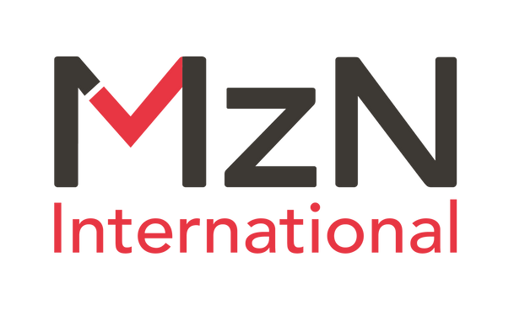





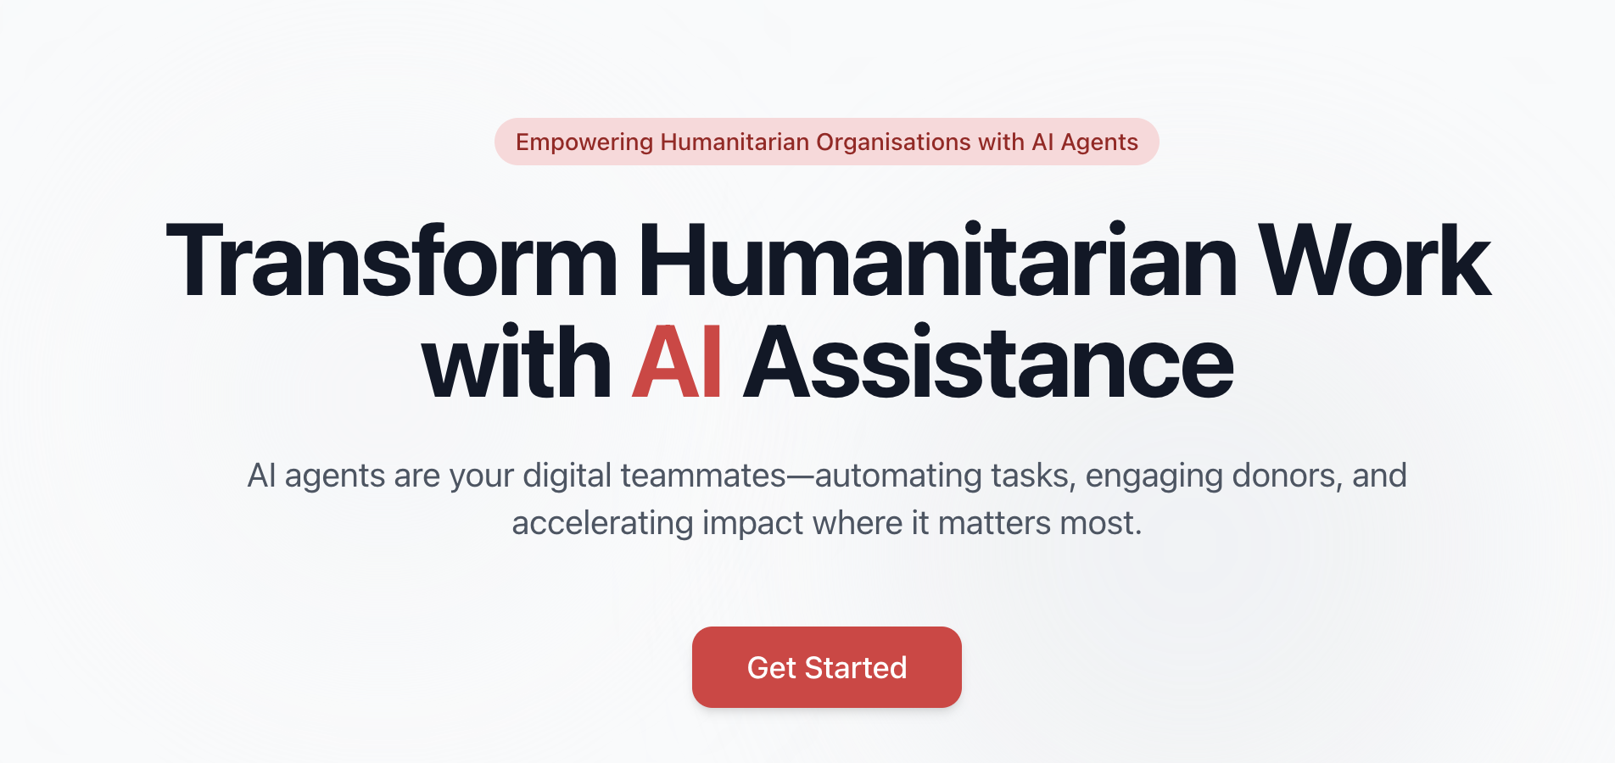

Donor trends in mid 2025 & AI use in fundraising
Presented by BOND in collaboration with MzN and HP Formerly KOIS Advisory.
Live Webinar
© 2025 MzN International, All rights reserved.

Slide 2




CHRISTIAN
CHRISTIAN MEYER ZU NATRUP
Managing Director
MzN International
© 2025 MzN International, All rights reserved.

Slide 3

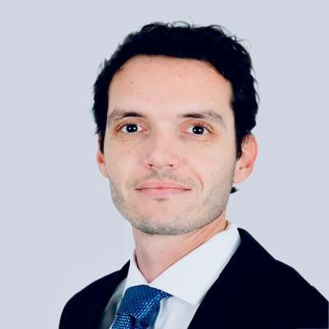
MEET OUR SPEAKERS
TONI-ANN ROBINSON
CÉDRIC JOUTET
CHRISTIAN MEYER ZU NATRUP
Consultant
MzN International
Principal
Human Planet (Formerly KOIS Advisory)
Managing Director
MzN International
© 2025 MzN International, All rights reserved.

Slide 4
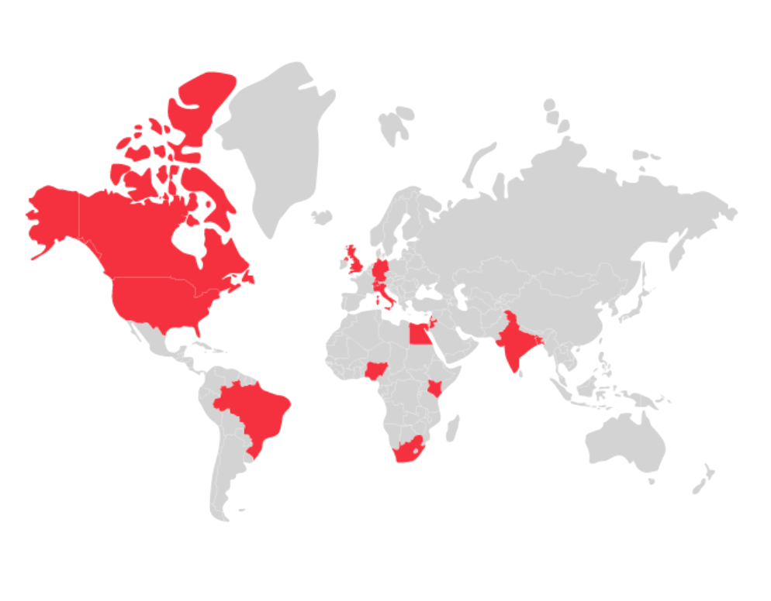
ABOUT MZN & HUMAN PLANET
At MzN, we help NGOs to be better funded, operate better and deploy smarter strategies
A social enterprise with many services subsidised. Training is already free for partners. In-person training is back!
While at HP, we integrate strategic advisory with innovative finance to mobilise outcomes globally, sustainably, and at scale for development, humanitarian and climate priorities globally.
© 2025 MzN International, All rights reserved.

Slide 5
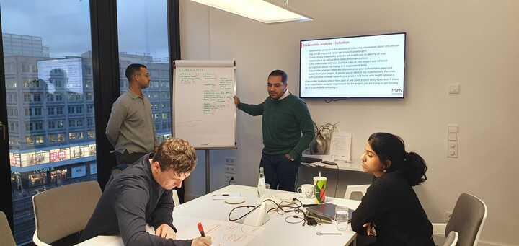
Why This Webinar Matters...?
  Continuing shifts in the donor landscape
  Outlook for the remainder 2025
  New developments in Artificial Intelligence
What You Will Learn
Session Objectives
  Understand key donor trends for this year and next
  Understanding how you and your NGO can adjust/pivot
  Learn more about how AI is being used in the sector
© 2025 MzN International, All rights reserved.

Slide 6

TONI, MID-YEAR DONOR TRENDS
TONI-ANN ROBINSON
Consultant
MzN International
© 2025 MzN International, All rights reserved.

Slide 7
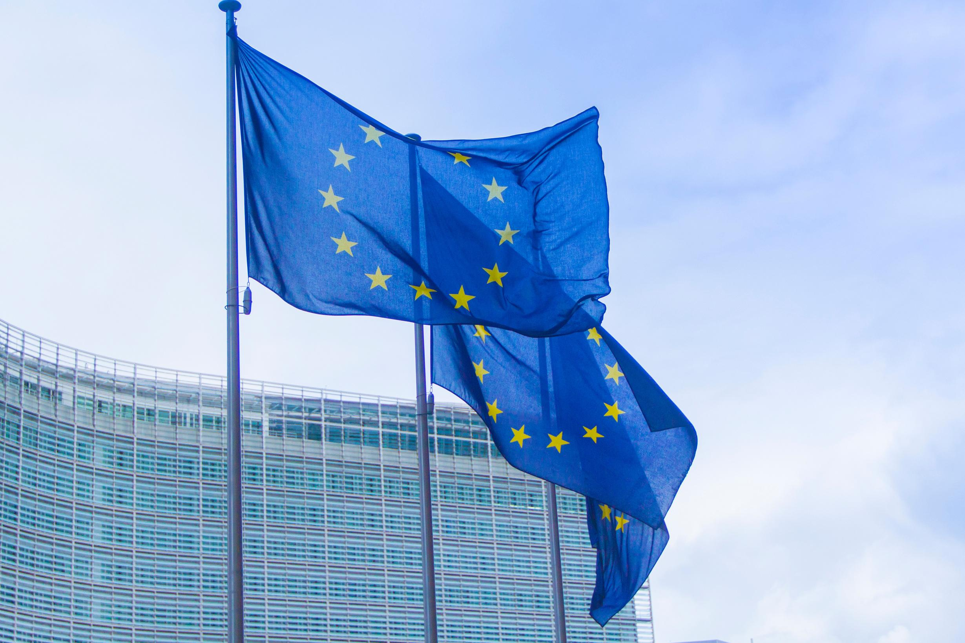



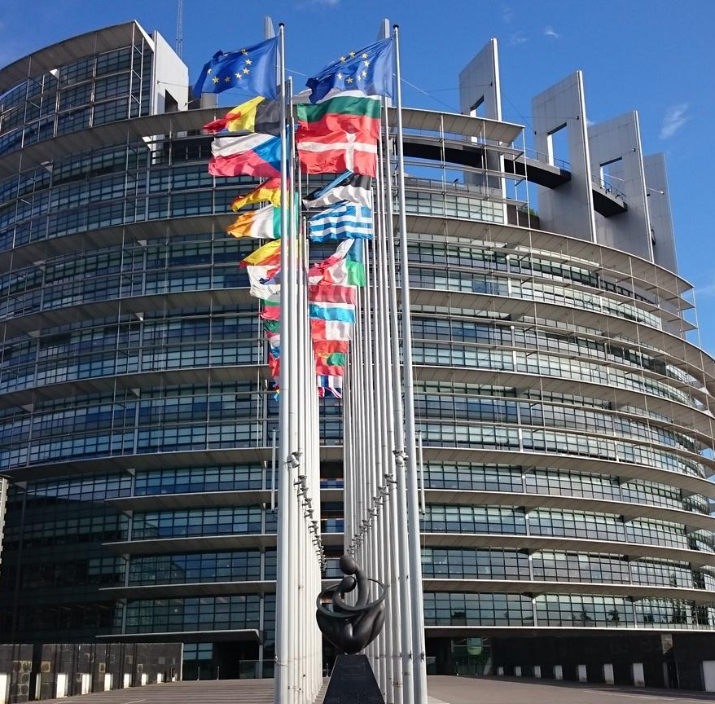

European Union/Commission
The EU budget 2028-2034 focuses on uniting various EU funds, coordinated by Member States and regions, under a coherent strategy.
To foster Education and Democratic Values:
Increased investment in skills, education, and civic engagement to empower citizens
Stronger Erasmus+ as the backbone of a "Union of Skills" promoting mobility, solidarity, and inclusiveness
A new Competitiveness Fund aimed at simplifying and accelerating access to both EU and private investments.
  It will particularly target four key areas: clean transition and decarbonization, digital transition, health (including biotech, agriculture, and the bioeconomy), and defence and space.
© 2025 MzN International,. All rights reserved.
Notes:
Like USAID before, the EU is also slowly moving towards using its limited funds to raise more private capital. Expect future EU programming to be less grants and more impact investments in future.
The "Foster education and democratic values" section of the EU budget 2028-2034 emphasizes increased investment in skills, education, and civic engagement to empower students, workers, and citizens. It commits to a stronger Erasmus+ programme as the backbone of a “Union of Skills,” supporting education mobility, solidarity, and inclusiveness. Additionally, the budget will bolster initiatives like the AgoraEU programme to promote democratic values, equality, the rule of law, media freedom, cultural diversity, and civil society involvement, ensuring these core principles are at the heart of the EU’s future development
The Competitiveness Fund will not only streamline funding but also maximize the impact of every euro by leveraging private investment and working in close connection with the Horizon Europe research programme. This approach supports projects from conception to market scale-up, reduces administrative burdens, and fosters technological independence and leadership for the EU

Slide 8

European Union/Commission
The EU budget will allocate EUR 131 billion allocated to defence, security, and space five times more funding than the previous period.
The Global Europe Instrument worth EUR 200 billion, to maximize the EU’s influence abroad, support candidate countries for EU accession, and respond to emerging global crises with a dedicated EUR 15 billion reserve.
The budget also apportions up to EUR 100 billion in flexible support for Ukraine, continues funding for Common Foreign and Security Policy actions, and funds the European Peace Facility.
What this means for NGOs in practice?
  Double down on EU readiness: compliance, controller‑level financials, safeguarding, environmental minimums, and audit trails for both grants and FSTP.
  Build consortia early, with clear complementarity and delivery track record.
  Prepare investable components: outcome frameworks, revenue logic where feasible, and roles in guarantee‑ or blended‑finance operations linked to Ukraine’s recovery and beyond.
© 2025 MzN International, All rights reserved.
Notes:
The plan also significantly increases resources for military mobility, cybersecurity, border protection, and migration management, including tripling funds for migration and borders to EUR 34 billion. Investments will support both civilian and military infrastructure, improve law enforcement capabilities, and ensure a fair and robust migration system, focusing on maintaining Europe’s security and preparedness
The Global Europe Instrument seeks to usher in a new ‘dual objective’: to foster partnerships that contribute “simultaneously to the sustainable development of partner countries and to the strategic interests of the Union” (Article 5). This represents a deliberate pivot towards a more assertive geoeconomic approach, explicitly positioning the Global Europe instrument as a tool to advance EU competitiveness, economic security, and open strategic autonomy. The Global Gateway strategy is now formally designated as the main vehicle of this economic foreign policy. Overall, it seeks to align the EU’s international funding with strategic interests, values, and effective crisis response

Slide 9
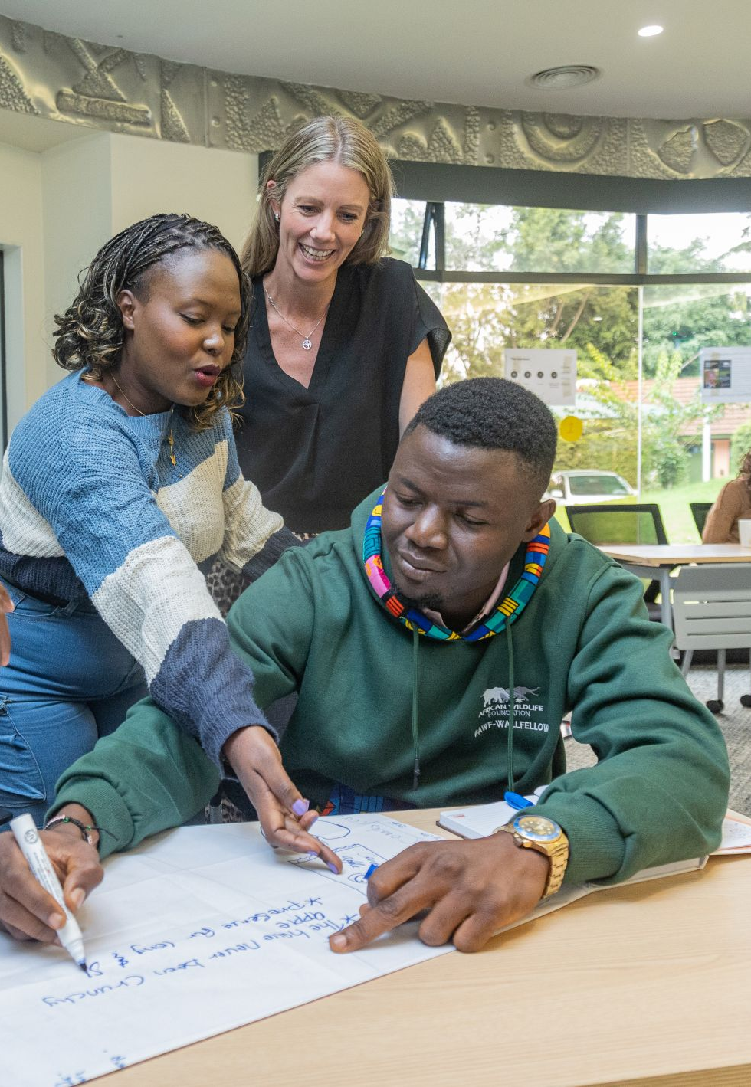
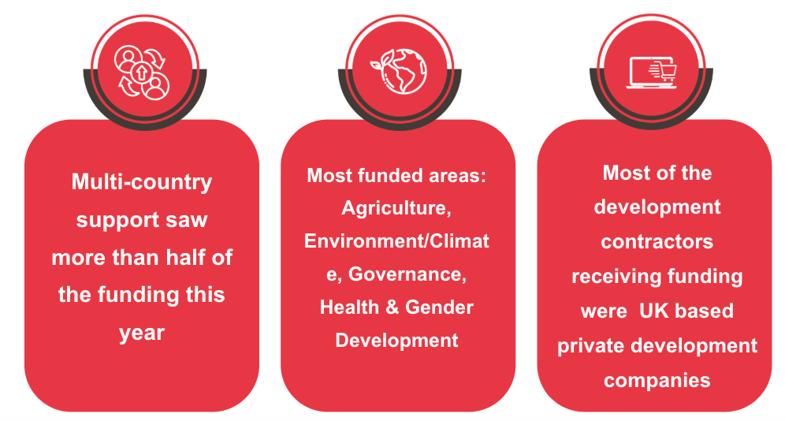
United Kingdom
The UK's 2025 development policy prioritises domestic interests, shifting its focus from traditional grants towards business-style investments that serve national goals.
Cuts are already impacting key areas like Research and Development, while the removal of the FCDO's 'spender of last resort' role means there is no guarantee the UK will meet even its reduced spending targets.
© 2025 MzN International, All rights reserved.
Notes:
This new approach is backed by deep spending cuts. The UK is reducing its Official Development Assistance (ODA) to 0.3% of GNI by 2027 - its lowest level in 25 years - with an immediate budget reduction of £0.5 billion.
Of the 1 billion disbursed, about 65% went to development focused work which is a substantial increase of over 20% from the previous year

Slide 10



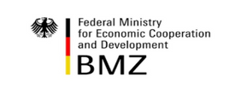
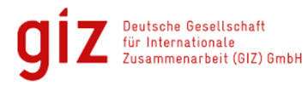
Germany
BMZ and AA
GIZ anticipates a volume decrease in 2025 after a flat 2024, indicating increased competition for commissions and more program bundling.
Both BMZ and AA humanitarian aid funding are decreasing, leading to fewer, larger, and more selective funding lines with a greater emphasis on value for money and measurable results.
BMZ & AA grants are limited:
  Organisations must: prioritise strong financial controls
  Safeguarding and climate baselines
  Ensure alignment with EU guidelines
Due to reduced grant funding, financing is shifting towards KfW loan-based operations and blended structures for partner countries with fiscal capacity, as evidenced by KfW's 2024 commitments.
Position with KfW operations by offering outcome measurement, safeguards, and local implementation to join loan-financed programs in high-commitment regions like Sub-Saharan Africa and MENA.
© 2025 MzN International, All rights reserved.
Notes:
The Foreign Office’s budget for humanitarian aid is also set to be more than halved by 2026.
German Grant Funding is Scarce: The availability of direct grant funding from BMZ and AA is decreasing. This means NGOs will face increased competition for fewer, but likely larger and more selective, grants.
Financial Prudence is Paramount: NGOs must demonstrate impeccable financial management. This includes robust internal controls, transparent accounting, and clear audit trails to prove efficient and responsible use of funds. German donors will scrutinize financial practices heavily to ensure value for money.
Adherence to Key Standards is Essential:
Safeguarding: NGOs need to have strong policies and practices in place to protect beneficiaries, staff, and communities from harm, exploitation, and abuse. This is a non-negotiable requirement.
Climate Baselines: Given Germany's emphasis on climate action, NGOs must demonstrate how their projects contribute to climate goals or at least operate in an environmentally responsible manner. This might involve setting baselines, measuring environmental impact, and integrating climate considerations into their operations.
EU Alignment is Crucial for Access: NGOs must ensure their strategies, operations, and proposed projects are aligned with broader EU guidelines and policies. This suggests that German funding, especially for larger initiatives, is increasingly linked to or influenced by EU priorities and frameworks, requiring NGOs to understand and adapt to these broader European directives.

Slide 11
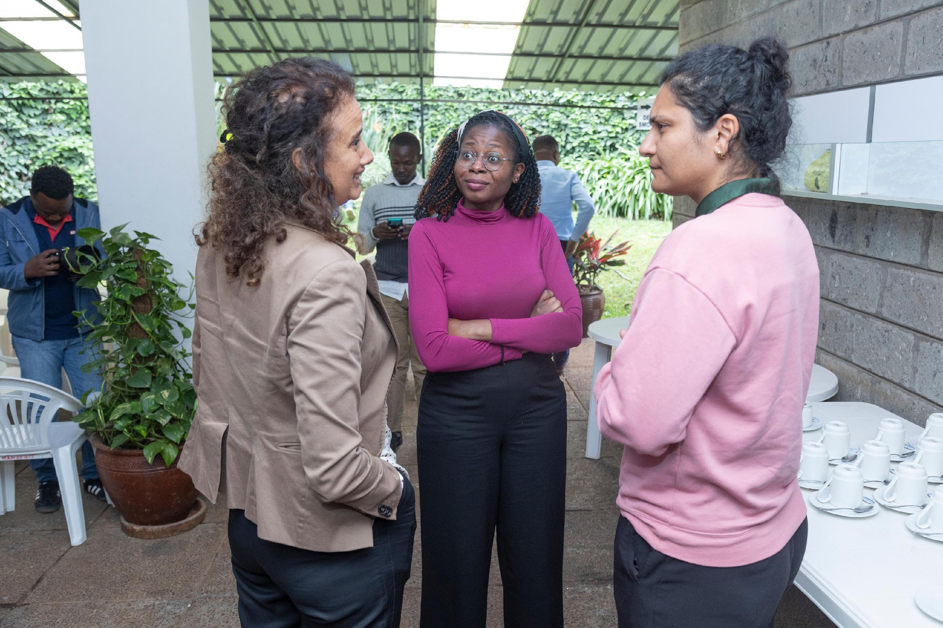
Foundations
These donors are playing their part in covering the gap and facilitate the continuation of important projects globally.
The Gates Foundation
The Gates Foundation has committed to doubling its spending over the next 20 years. By 2045, $200 billion will have be spent on improving the safety and quality of lives around the world - the largest philanthropic commitment in modern history.
How can NGOs leverage:
MacArthur Foundation
  Target impact-aligned capital and high-net-worth donors
  Offer flexible funding models and reduced reporting burdens
  Use match-funding and collective platforms to expand reach
MacArthur Foundation raises giving rate to 6% of its US $8.7 bn endowment (+~US $150 m)
Growth of collective giving and giving circles
Rise in trust-based philanthropy with unrestricted, multi-year grants shift toward strategic, values driven funding & capacity building
© 2025 MzN International, .All rights reserved.
Notes:
These philanthropies are stepping in to buy time and support diversification—but cannot replicate USAID scale quickly especially especially in global health infrastructure, workforce, and technical leadership.
The boundary between philanthropy & impact investing/venture philanthropy continues to blur as donors seek both social and financial return in their giving. Philanthropic and business practices are increasingly converging, potentially redefining the expectations of donors regarding the returns on their contributions.
More competition for high-impact, values-aligned projects
Faster decision cycles and preference for deep partnerships
Greater scope for flexible, multiyear support
Propose flexible funding models: This implies that NGOs should be open to and perhaps even initiate discussions about funding structures that are adaptable and less restrictive than traditional project-specific grants. This could include core operating support, unrestricted funding, or multi-year commitments, allowing NGOs greater agility in how they use the funds to achieve their mission.
For nonprofits, securing funding can be greatly enhanced by using two key strategies: match-funding and leveraging collective platforms. Match-funding is a strategy where a large donor, like a foundation, agrees to donate money only if the organization can raise a specific amount from other sources. This approach makes the foundation's investment go further and shows that the nonprofit has a broad base of support. Another effective strategy is to engage with collective platforms, such as giving circles, crowdfunding sites, and philanthropic consortia. By participating in these groups, nonprofits can access wider networks of donors, connect with new supporters, and take part in larger, more impactful projects that might otherwise be out of reach.

Slide 12
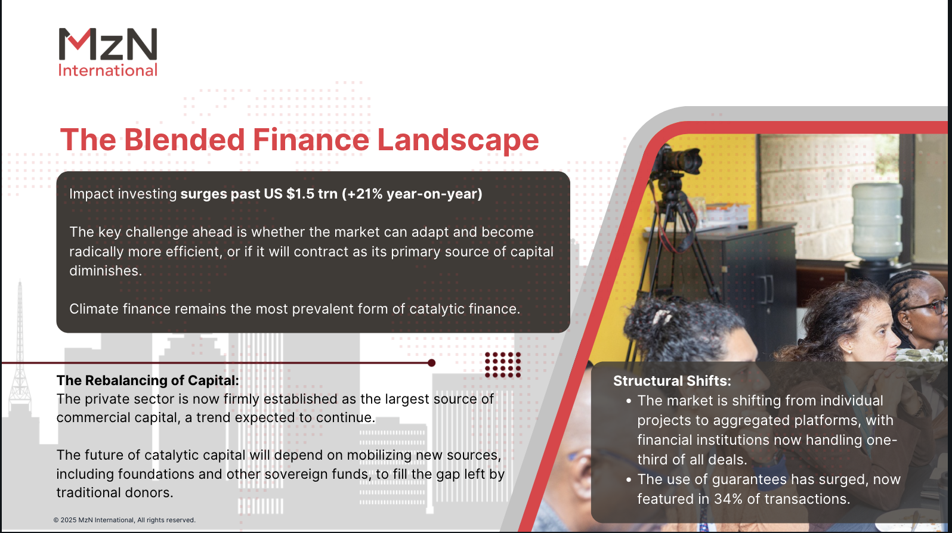

Slide 13


The Path to 2026: Critical Challenges & Strategic Imperatives
Strategic Imperatives for Growth:
Imminent Challenges:
Programmes should be able to be replicable and scale. Less one offs.
Invest in your Business development to manage the change from grants to innovative finance
From “replying to an RfP”-
to “designing a programme & sell it”
Invest in AI to take the workload of grant applications. See here for useful AI tools
Considerable potential for growth and progammes that are longer term
Recognise that there a LOT of change and take care of each other!
Finance and Business Development teams need to change the most.

Slide 14

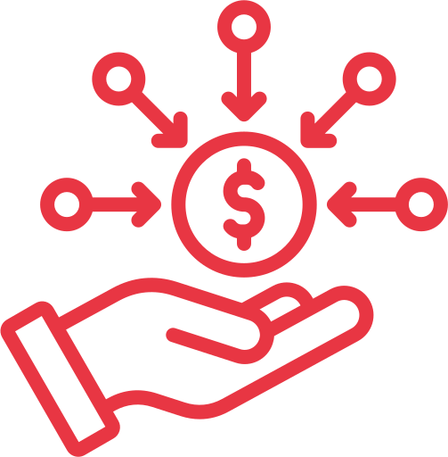
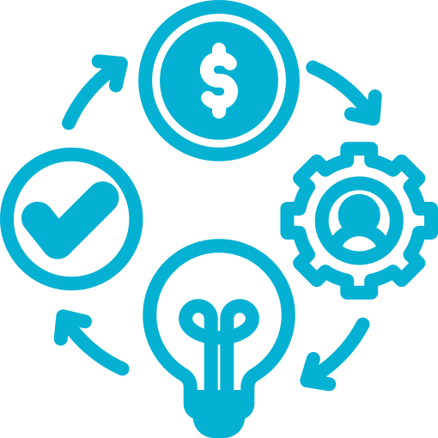


Stop reacting! Respond strategically.
Diversify, Redesign Business Models, Harness AI, and Forge Partnerships to Thrive in the New Funding Landscape
Diversify funding sources
Evolve your business model
Leverage AI in operations
Build strategic partnerships
Reduce reliance on any single donor by actively pursuing EU, Nordic, German, philanthropic, and multilateral opportunities.
Shift from grant-dependency to adaptable models that integrate blended finance, outcome-based funding, impact investment, and technology-driven efficiency.
Embed AI tools for donor intelligence, proposal development, impact tracking, and operational efficiency to free staff for strategic and relationship-building work.
Pre-form strong consortia, position as a technical partner in large programmes, and leverage match-funding or giving circles.
© 2025 MzN International, All rights reserved.

Slide 15
CHRISTIAN
CHRISTIAN MEYER ZU NATRUP
Managing Director
MzN International
© 2025 MzN International, All rights reserved.

Slide 16
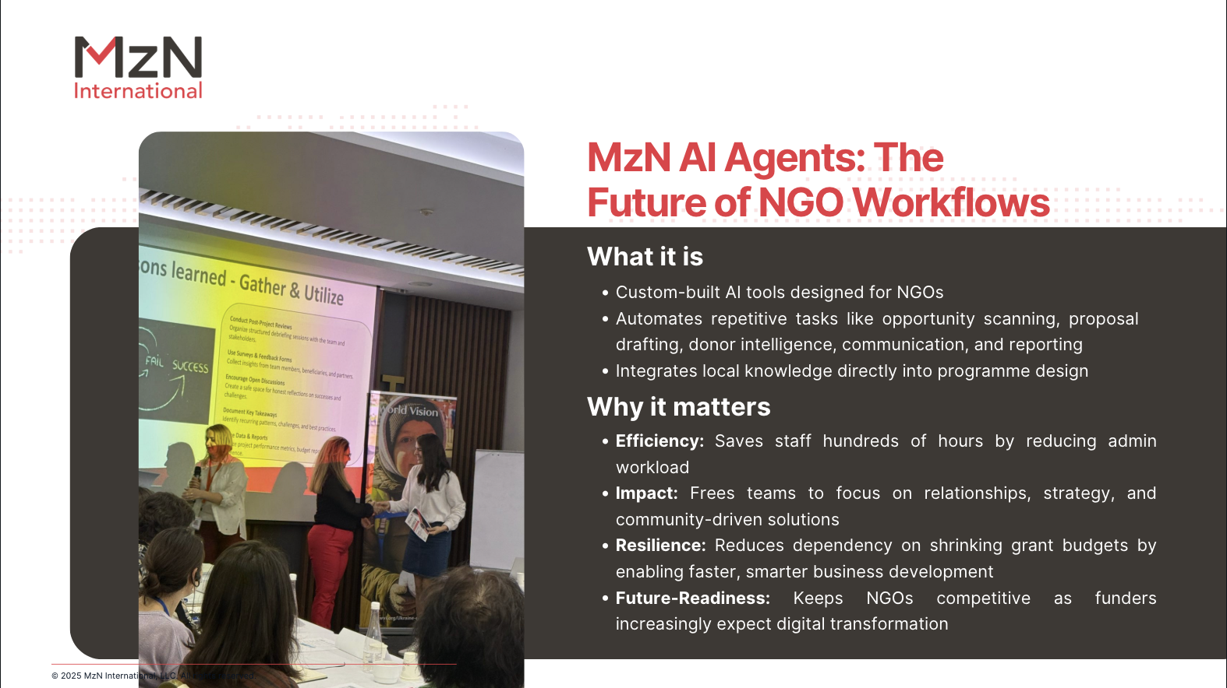

Slide 17
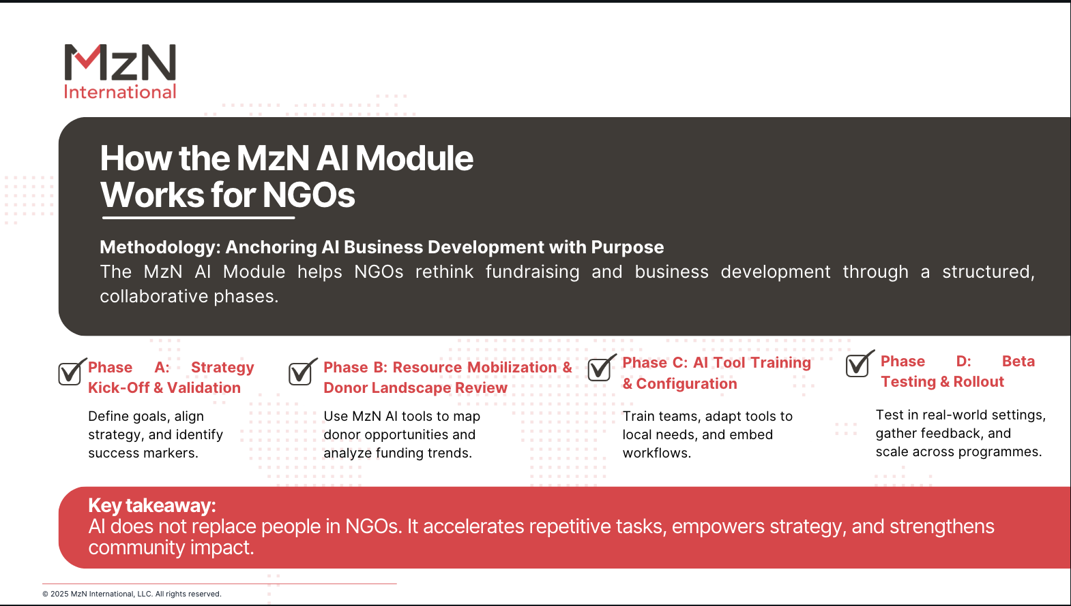

Slide 18
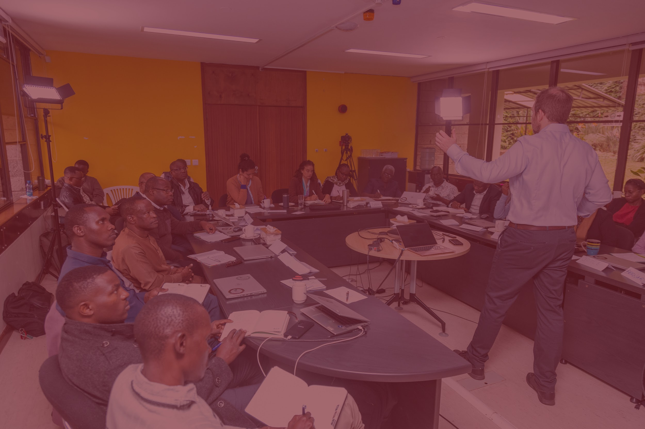
Watch MzN AI Live DEMO
© 2025 MzN International, All rights reserved.

Slide 19
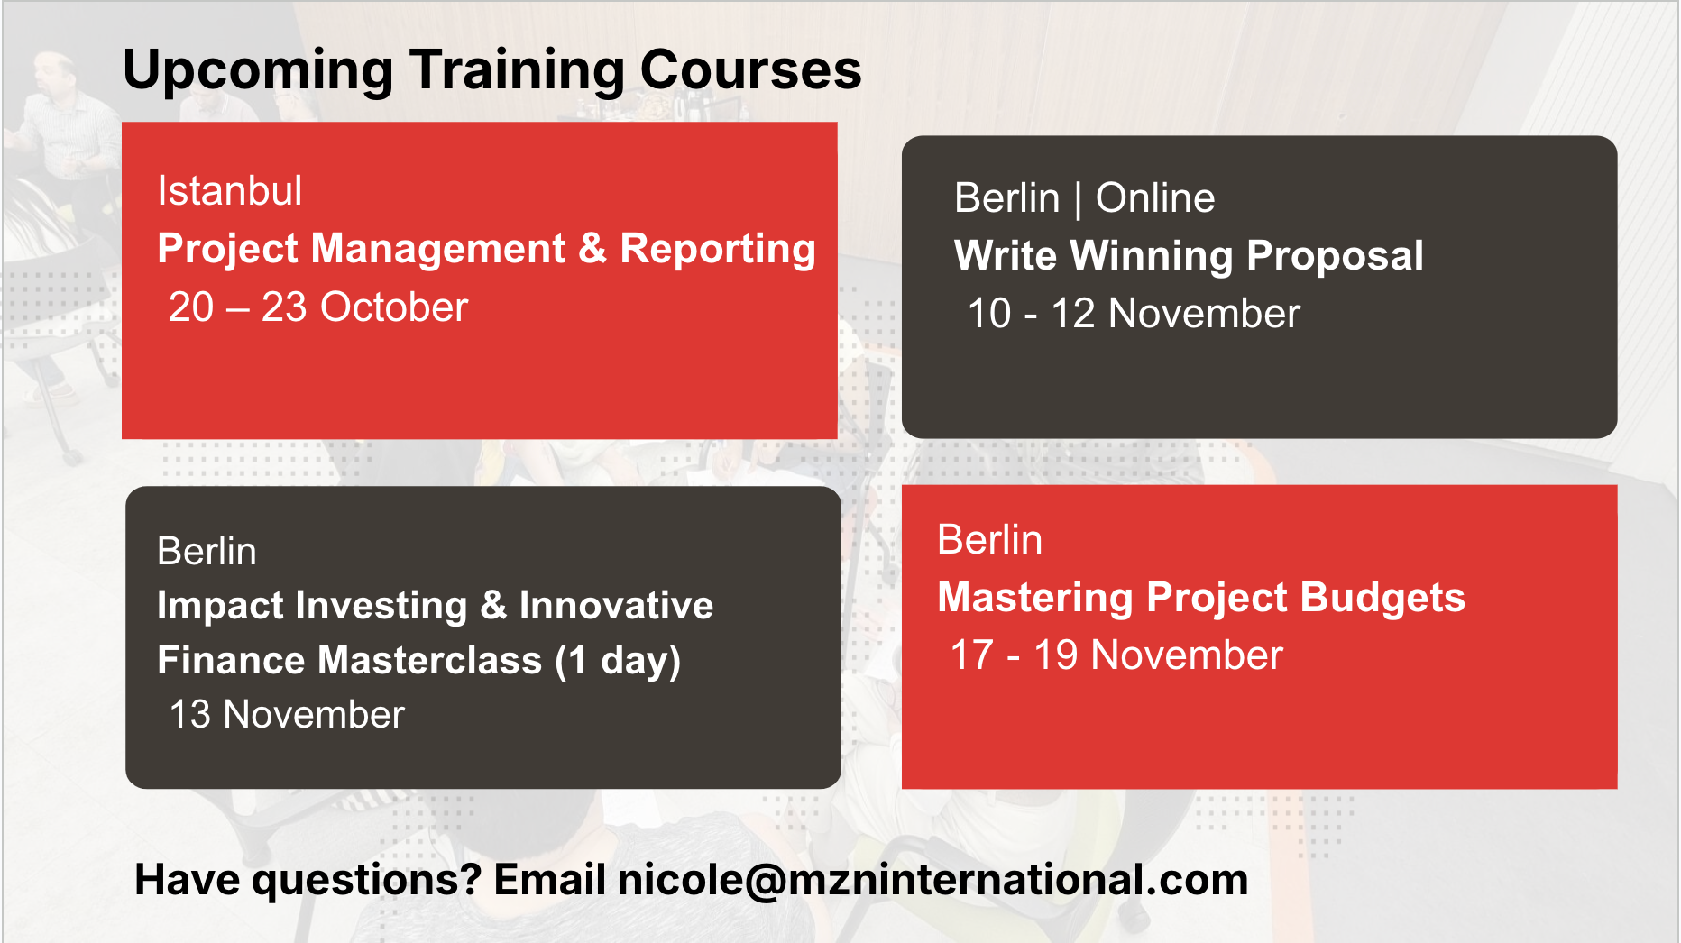

Slide 20



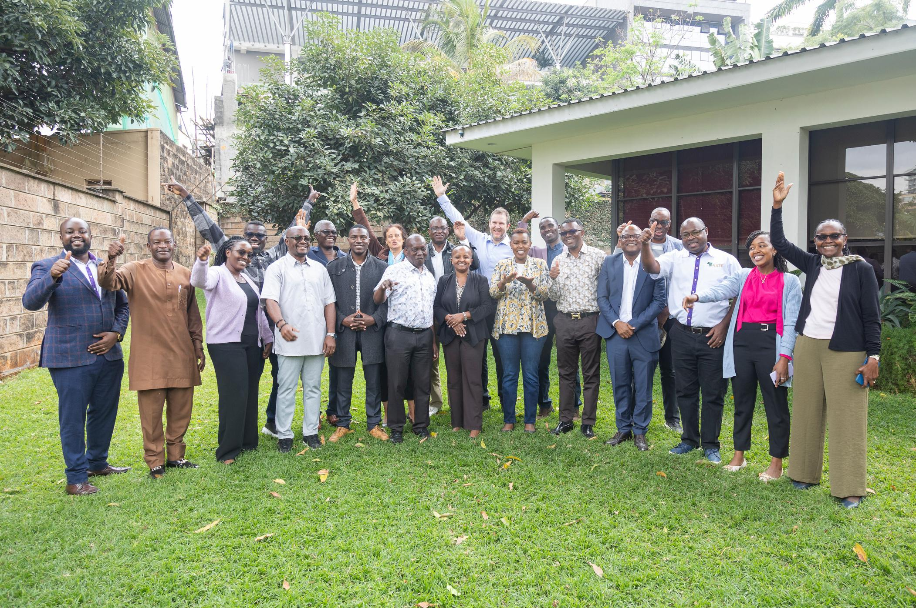






BIG THANKS
Get in touch!
www.mzninternational.com

