Slide 1
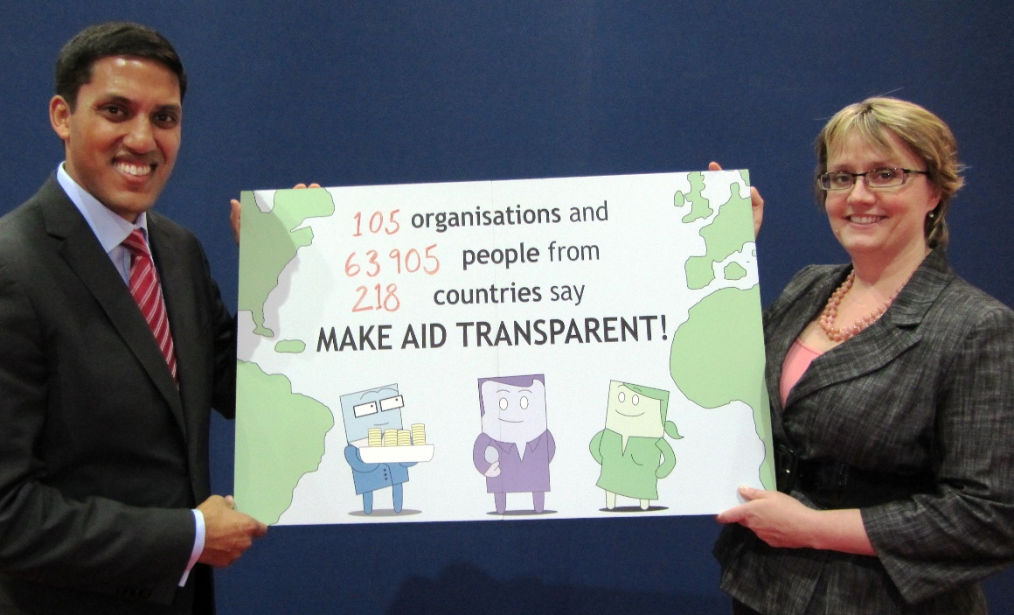
What is the Aid Transparency Index and why did we start it?
Our solution:
The Aid Transparency Index assesses organisations’ overall commitment to transparency, as well as the information they publish at the organisational level and for individual activities. It tracks and encourages progress, while holding donors to account.
The problem back in 2010: Aid’s not transparent! Across some of the largest and most established aid donors, information is patchy, inconsistent and hard to compare between agencies.

Slide 2
How has the Aid Transparency Index evolved?
In 2011, the International Aid Transparency Initiative (IATI) was agreed as a common data standard. For the first time there was agreement on how aid information should be published, making it possible to standardise Index formats.
In 2012, major aid donor organisations started to recognise the value of the Aid Transparency Index:
“We appreciate your leadership in advancing this agenda.” – Jim Yong Kim, President of the World Bank
In 2013, we launched the Aid Transparency Tracker which highlights what information donors have committed to publish, as well as what they are currently publishing.
In 2014, we launched the Road to 2015 Campaign at the United Nations to continue to push donors to publish what they fund.
In 2015, we launched the U.S. and EU Aid Transparency Reviews to spur on greater progress from major donor organisations within these blocs.
The 2016 Aid Transparency Index showed that since the first full Index in 2011, ten donors accounting for 25% of global aid met their commitment and published their aid information. Whilst we laud this progress, more remains to be done and we now intend to raise the bar.

Slide 3
How do aid donors respond to the Index?
“Publish What You Fund’s annual assessment is very powerful driver for improving reporting on aid transparency… you [Publish What You Fund] really motivated us to work very hard… we’ve seen [the Index] as a huge incentive to work to excel.” – Helen Clark, Administrator, UNDP, 2016 Index launch
“[The Aid Transparency Index] is a big deal for us. We care about this a lot. This is part of our culture… it’s part of our DNA.” – Nancy Lee, deputy CEO of the U.S. Millennium Challenge Corporation

Slide 4
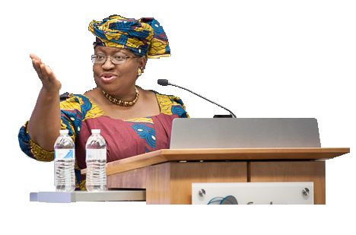
What impact have we had?
“Aid transparency is not just about aid. It goes further, into how that interrelates with all finances of the whole country… it’s good for donors to publish what they fund… but along the line, it’s all about the impact on the budget.” – Ngozi Okonjo-Iweala, Minister of Finance, Nigeria, 2014 Aid Transparency Index launch
“Incredible as it may seem, just 12 months ago [the U.K.] government did not publish details of how our development money was spent… today, people all around the world can go online and see every item of DFID spending over £500 and see evaluations of the impact of that spending.” – Former U.K. Prime Minister David Cameron, June 2011

Slide 5
Why is the Index more important than ever?
Aid transparency first made it onto the global political agenda in 2011 at the Busan Conference. In Busan, Secretary of State Hillary Clinton affirmed the U.S.’s commitment to the IATI standard:
Five years later, we need to renew the case for aid in a new political environment. Transparency will be key to making that case. We are pleased to see transparency at the heart of DFID’s civil society policy, and our recommendations to the incoming U.S. administration emphasise the role of data in holding government institutions to account.
The Aid Transparency Index has brought about real change in a short period of time and for us to keep up the momentum and raise the bar, we need the support of like-minded peers and colleagues from across all stakeholder groups.
“I’m pleased to announce that the United States will join the International Aid Transparency Initiative, and we will report on data in a timely, easy-to-use format.”

